Slide 1
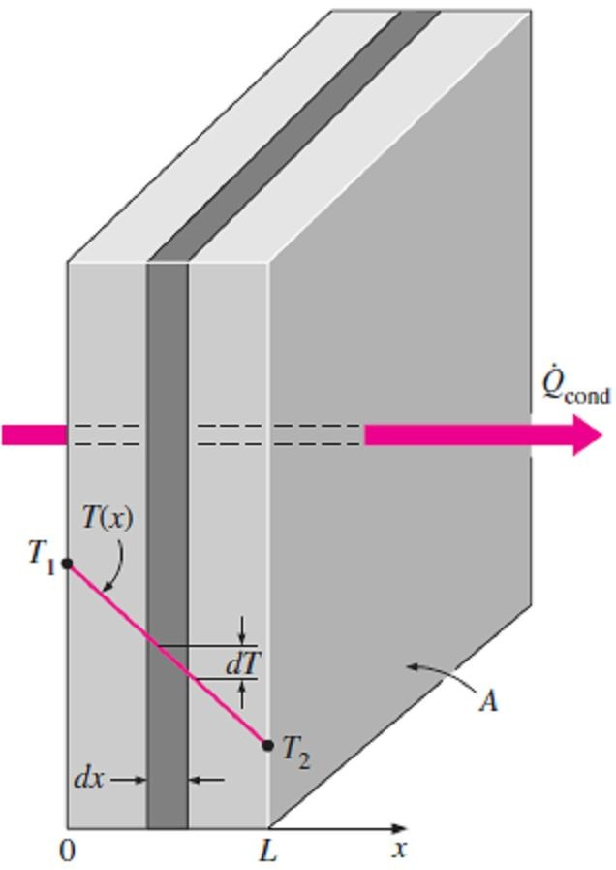
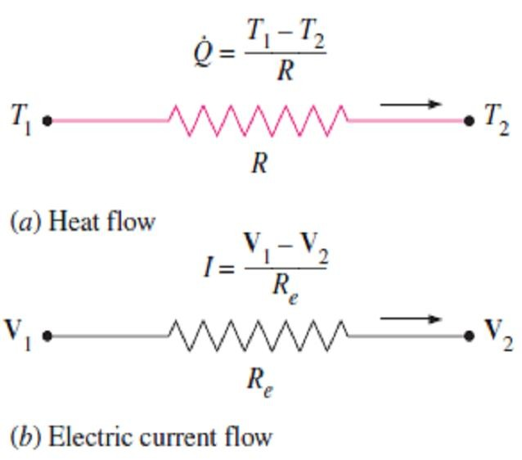
Chapter Three
Steady Heat Conduction
3.1- Steady Heat Conduction in Plane Walls
Consider a plane wall of thickness L and average thermal conductivity k. The two surfaces of the wall are maintained at constant temperatures of T₁ and T₂. For one-dimensional steady heat conduction through the wall, we have that T=T(x) only. Then Fourier’s law of heat conduction for the wall can be expressed as;
_{Q}
cond, wall
= −k A ^{dT} (W ) ☹(3.1)
dx
where the rate of conduction heat transfer Q_{cond, wall} and the wall area A
are constant. Thus we have dT/dx=constant, which means that the temperature through the wall varies linearly with x, as shown in Fig.(3.1). By Separating the variables in the above equation and integrating from x=0, where T(0)= T₁, to x=L, where T(L)=T₂, we get;
L T
∫
_{Q}
∫
2
x=0
cond , wall
dx = − k A dT
T =T₁
Fig.(3.1) Under steady conditions, the temperature distribution in a plane wall is a straight line
By performing above integrations and rearranging gives;
_{Q}
_{= k A} T₁ − T₂
(W ) ☹(3.2)
cond , wall
L
Note1- As we say in chapter1, and as it is clear from above equation, the rate of heat conduction through a plane wall is proportional to the average thermal conductivity, the wall area, and the temperature difference, but is inversely proportional to the wall thickness.
Note2- If the rate of heat conduction is available, the temperature T(x) at any location x can be determined by replacing T₂ in Eq.(3.2) by T, and L by x.
3.1.1- The Thermal Resistance Concept
Fourier’s law [Eq.(3.2)] for heat conduction through a plane wall can be rearranged as;
_{Q}
₌ T₁ − T₂
(W ) ☹(3.3.a)
cond, wall
R
cond, wall
where;
₌ L
R
cond , walll
k A
(C □ / W ) ☹(3.3.b)
which is the thermal resistance of the wall against heat conduction or simply the conduction resistance of the wall.
Note1- The thermal resistance of a medium depends on the geometry
and the thermal properties of that medium.
Note2- The equation above for conduction heat flow is analogous to the relation of Ohm's law for electric current flow I, which expressed as;
_{I =} V₁ − V₂
( Amp) ☹(3.4)
R_{e}
where R_{e} is the electric resistance and V₁ - V₂ is the voltage difference across the resistance. Thus, the rate of heat transfer through a layer corresponds to the electric current, the thermal resistance corresponds to electrical resistance, and the temperature difference corresponds to voltage difference across the layer as shown in Fig.(3.2).
Fig.(3.2) Analogy between thermal and electrical resistance concepts

Slide 2
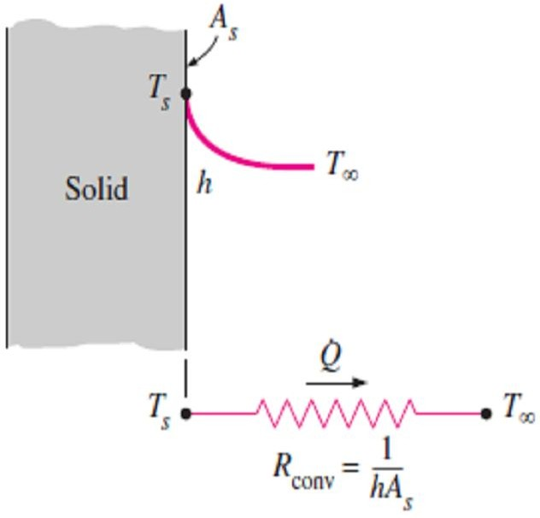
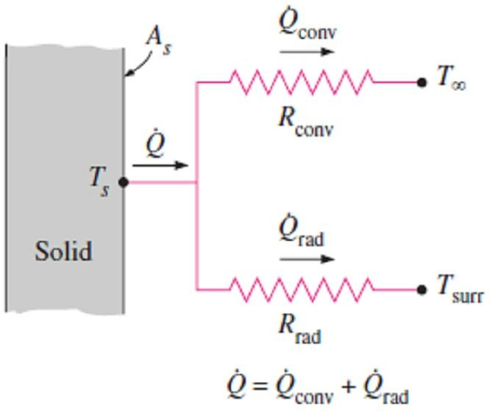
Chapter Three
Steady Heat Conduction
Note3- Consider convection heat transfer from a solid surface of area A_{s} and temperature T_{s} to a fluid whose temperature is T∞, with a convection heat transfer coefficient h. Newton’s law of cooling for
convection heat transfer rate Q_{conv} = h A_{s} (T_{s} −T∞ ) can be rearranged as;
_{Q}
₌ T_{s} − T∞
(W ) ☹(3.5.a)
conv
R
conv
where;
₌ 1
R
conv
h A
(C □ / W ) ☹(3.5.b)
s
is the thermal resistance of the surface against heat convection, or simply the convection resistance of the surface as shown in Fig.(3.3).
Fig.(3.3) Schematic for convection resistance at a surface
Note4- When the wall is surrounded by a gas, the radiation effects, which we have ignored so far, can be significant and may need to be considered. The rate of radiation heat transfer between a surface of emissivity ε and area A_{s} at temperature T_{s} and the surrounding surfaces at some average temperature T_{surr} can be expressed as;
_{Q}
rad
=   A (T ⁴ − T ⁴ ) = h A (T − T
s s surr rad s s surr
₎ ₌ ^{T}s ^{− T}surr
(W ) ☹(3.6.a)
R
rad
where;
₌ 1
R
rad
h A
(K □ /W ) ☹(3.6.b)
rad s
is the thermal resistance of a surface against radiation, or the radiation resistance, and;
h =
^{Q}rad
=   (T ² + T ² )(T + T ) (W / m² K □ ) ☹(3.6.c)
s surr s surr
rad
A (T − T )
s s surr
is the radiation heat transfer coefficient. Note that both T_{s} and T_{surr} must be in K° in the evaluation of h_{rad}.
Note5- A surface exposed to the surrounding air involves convection and radiation simultaneously, and the total heat transfer at the surface is determined by adding (or subtracting, if in the opposite direction) the radiation and convection components. The convection and radiation resistances are parallel to each other, as shown in Fig.(3.4), and may cause some complication in the thermal resistance network. When T_{surr} ≈ T∞, the radiation effect can properly be accounted for by replacing h in the convection resistance relation by;
h = h + h (W / m² K □ ) ☹(3.7)
combined conv rad
Fig.(3.4) Schematic for convection
where h_{combined} is the combined heat transfer coefficient.
and radiation resistances at a surface
3.1.2- Thermal Resistance Network
Now consider steady one-dimensional heat flow through a plane wall of thickness L, area A, and thermal conductivity k that is exposed to convection on both sides to fluids at temperatures T_{∞1} and T_{∞2} with heat transfer coefficients h₁ and h₂, respectively, as shown in Fig.(3.5). Assuming T_{∞1} > T_{∞2}, the variation of temperature will be as shown in the figure. Under steady conditions we have;
⎛ Rate of Rate of
⎜
⎞
⎛ ⎞ ⎛ Rate of ⎞
⎟ ⎜
⎟ ⎜
⎟
⎜ heat convection ⎟ = ⎜ heat conduction ⎟ = ⎜ heat convection⎟
⎜
into the wall
⎟
⎜through the wall ⎟
⎜
from the wall ⎟
⎝
⎠ ⎝
⎠ ⎝
⎠

Slide 3
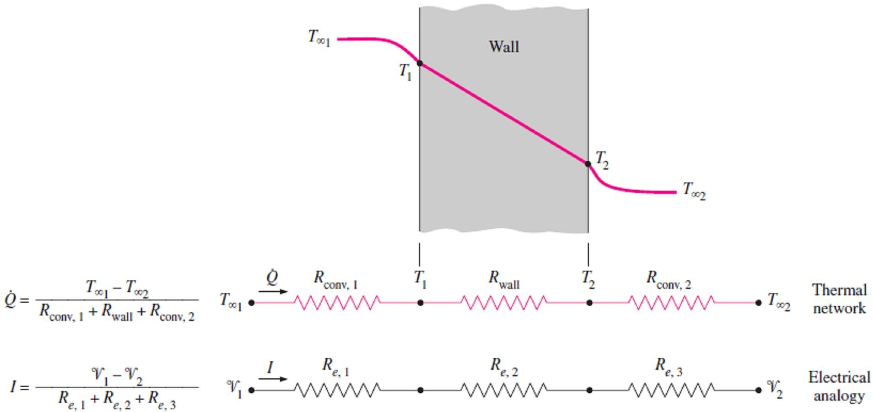
Chapter Three
Steady Heat Conduction
or;
T − T
Q = h A (T
T ) = k A
1 2
L
= h A (T − T
) ☹ (3.8.a)
1 ∞1 1
2
2 ∞ 2
which can be rearranged as;
_{Q =} T_{∞1} − T₁ ₌ T₁ − T₂ ₌ T₂ − T_{∞ 2}
1 /( h₁ A) L /(k A) 1 /(h₂ A)
₌ T_{∞1} − T₁ ₌ T₁ − T₂ ₌ T₂ − T_{∞ 2}
^{R}conv ,1 ^{R}cond , wall ^{R}conv , 2
☹ (3.8.b)
or it can be represented in terms of total thermal resistance R_{total} as follow;
_{Q} ₌ ^{T}∞1 ^{− T}∞ 2
^{R}total
where;
(W ) ☹(3.9.a)
R = R + R + R
₌ 1 ₊ L ₊ 1
(C □ / W ) ☹(3.9.b)
total conv ,1 cond , wall conv , 2
h A k A h A
2
Note- It is sometimes convenient to express heat transfer through a medium in an analogous manner to
Newton’s law of cooling as follow;
Q =U A ΔT_{total} (W ) ☹(3.10.a)
where U is the overall heat transfer coefficient. A comparison of Eqs. (3.10.a) and (3.9.a) shows that;
1
U A =
1
^{R}total
= ₁
1
L 1
+ +
h₁ A k A h₂ A
or;
1
^{R}total ^{A}
U =
=
1
1 ₊ L ₊ 1
(W / m ² C □ )
☹(3.10.b)
h₁ k h₂
Therefore, for a unit area, the overall heat transfer coefficient is equal to the inverse of the total thermal resistance.
Fig.(3.5) The thermal resistance network for heat transfer through a plane wall subjected to convection on both sides, and the electrical analogy

Slide 4
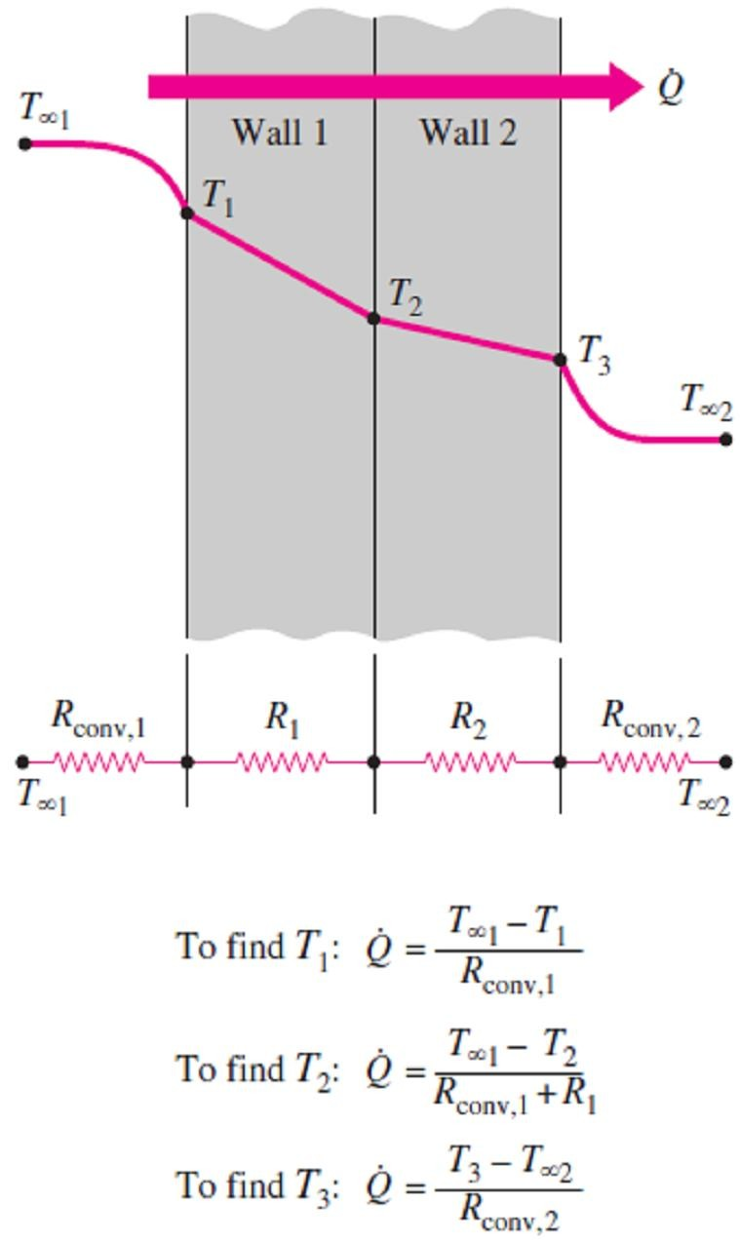
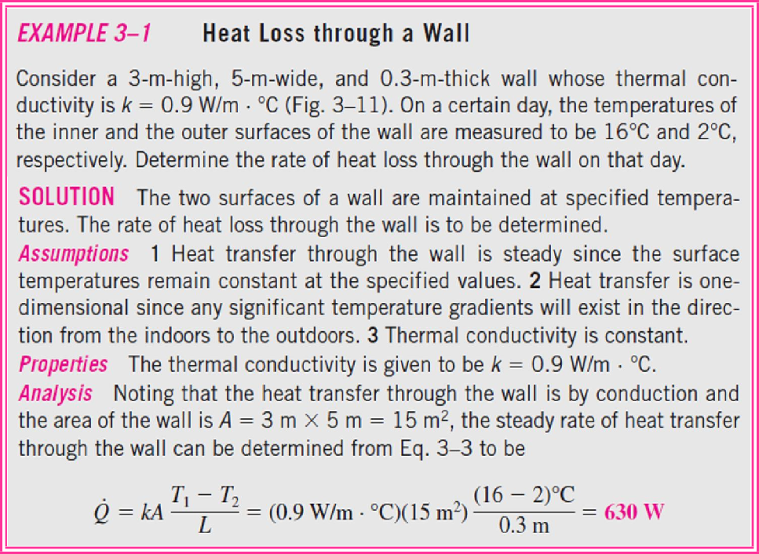
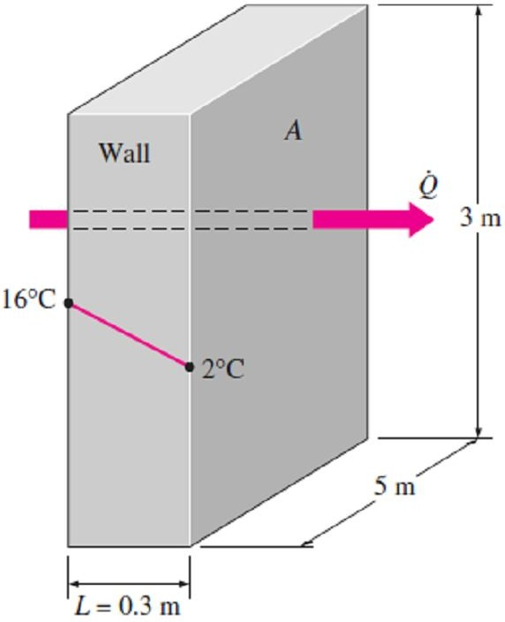
Chapter Three
Steady Heat Conduction
3.1.3- Multilayer Plane Walls
Consider a plane wall that consists of two layers (such as a brick wall with a layer of insulation) as shown in Fig.(3.6). The rate of steady heat transfer through this two-layer composite wall can be expressed as;
_{Q} ₌ ^{T}∞1 ^{− T}∞ 2
(W ) ☹(3.11.a)
^{R}total
where R_{total} is the total thermal resistance, expressed as;
^{R}total ^{= R}conv ,1 ^{+ R}wall ,1 ^{+ R}wall , 2 ^{+ R}conv , 2
₌ 1 ₊ L₁ L₂ ₊ 1
+ ☹(3.11.b)
h₁ A k₁ A k₂ A h₂ A
Note1- Above result for the two-layer case is analogous to the single-layer case, except that an additional resistance is added for the additional layer. So, for plane walls that consist of three or more layers we can use this result by adding an additional resistance for each additional layer.
_{Q}
Note2- If the heat rate is known, an unknown surface
temperature T_{j} at any surface or interface j can be determined as shown in Fig.(3.7) from;
_{Q =} T_{i} − T _{j}
(3.12)
Fig.(3.6) The thermal resistance network for heat transfer through a two-layer plane wall subjected to convection on both sides and the evaluation of the surface and interface temperatures when T_{∞1} and T_{∞2} are given
^{R}total , i − j
where T_{i} is a known temperature at location i and (R_{total, i – j}) is the total thermal resistance between locations i and j.
3.1-
Fig.(3.7).
Fig.(3.7) Schematic for Example- 3.1

Slide 5
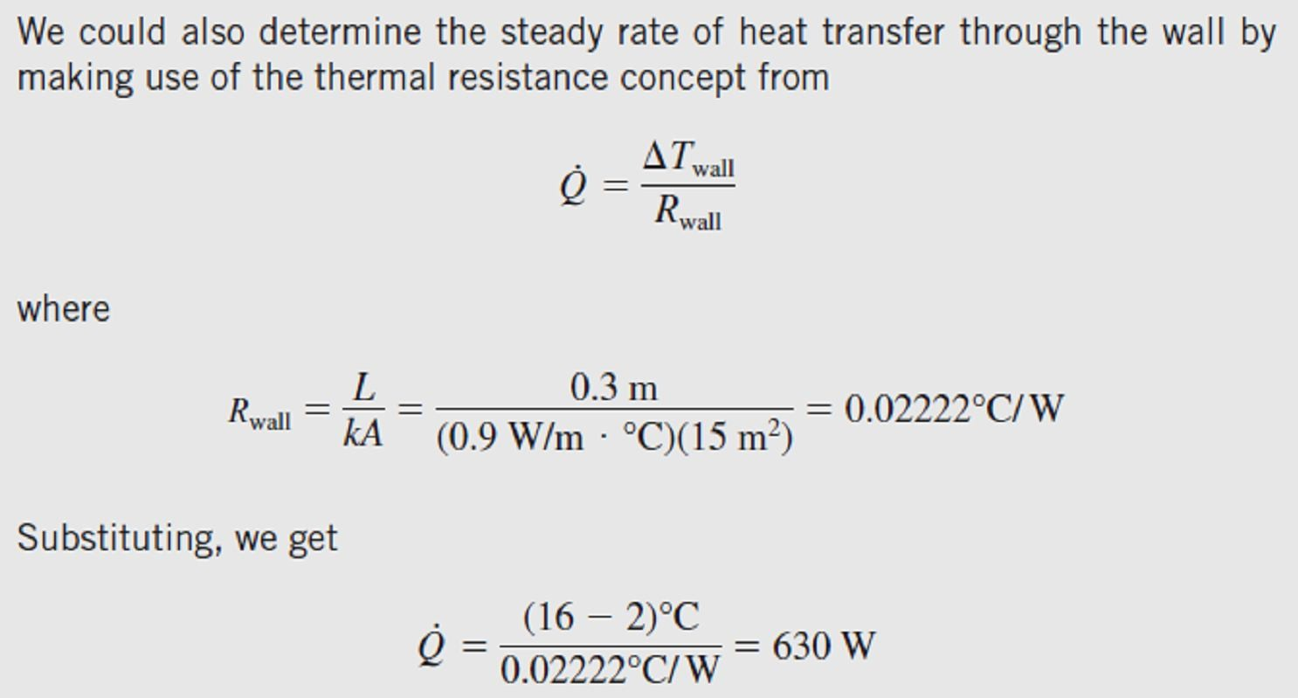
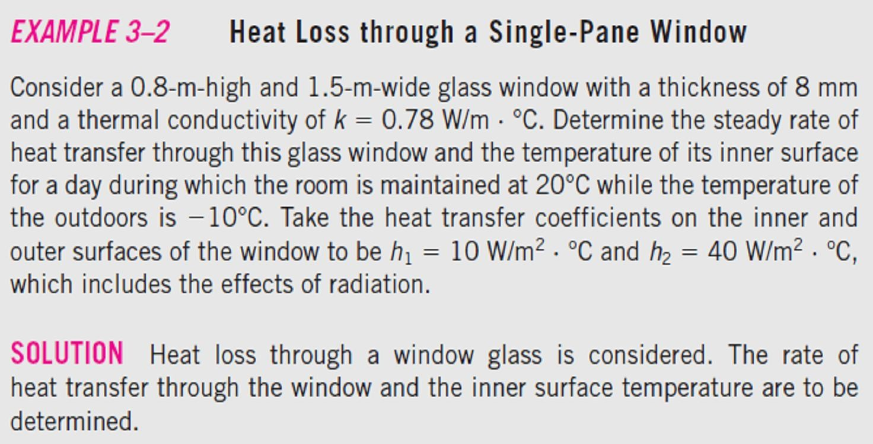
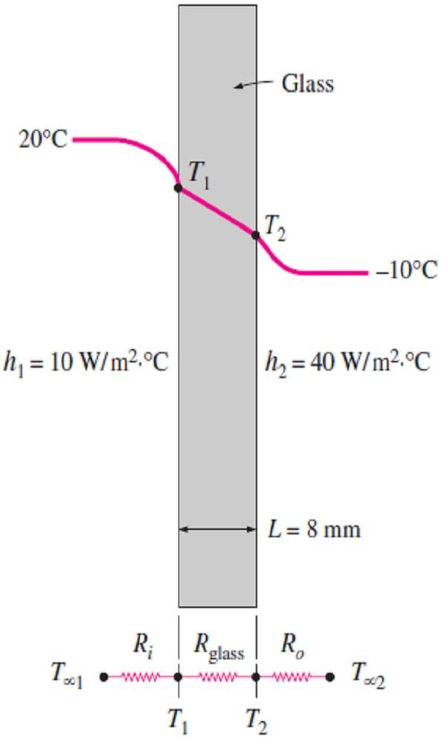
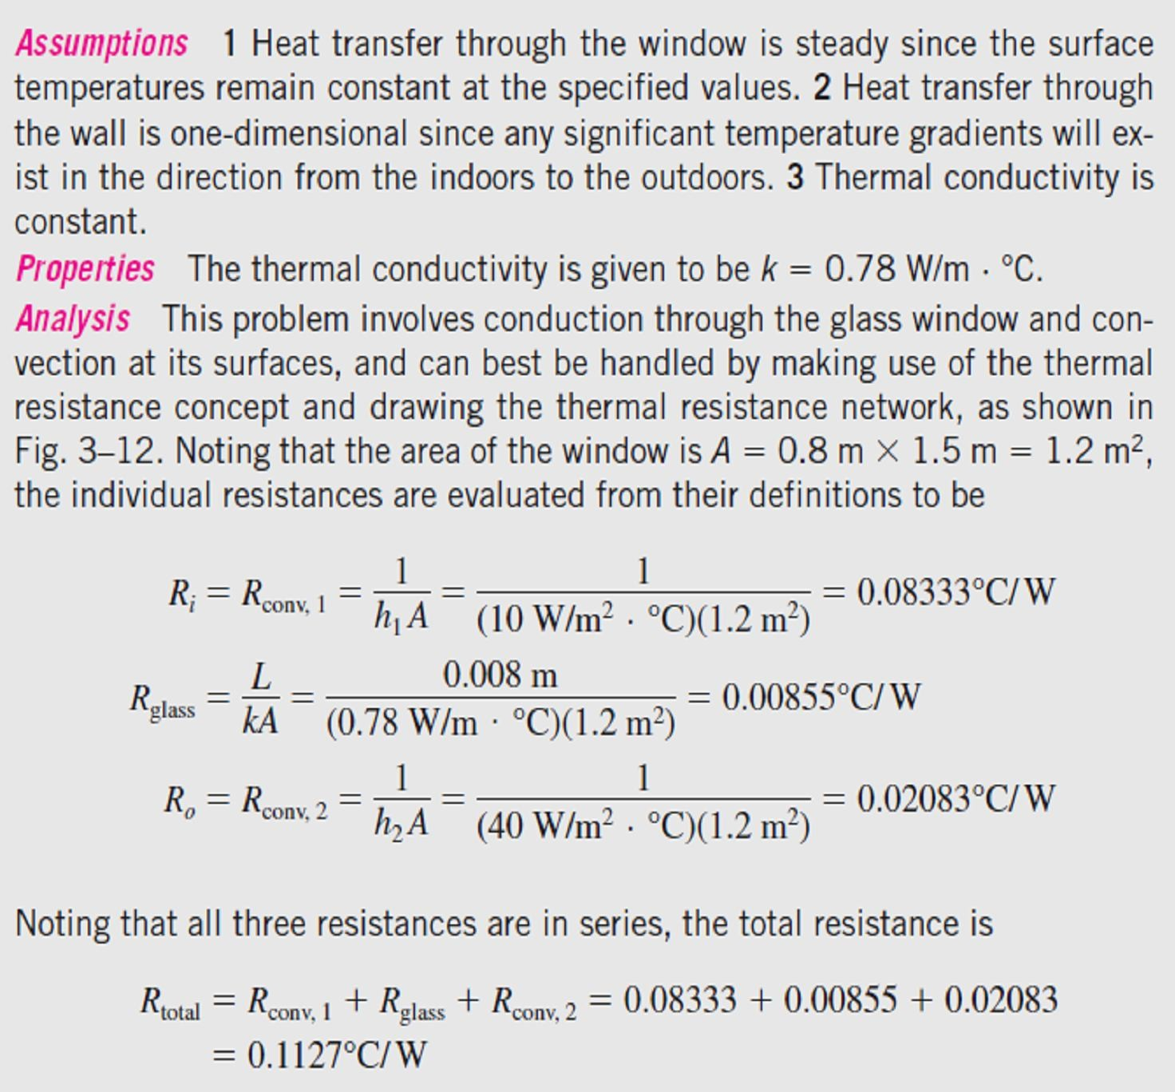
Chapter Three
Steady Heat Conduction
Fig.(3.8).
3.2-
Fig.(3.8) Schematic for Example- 3.2

Slide 6
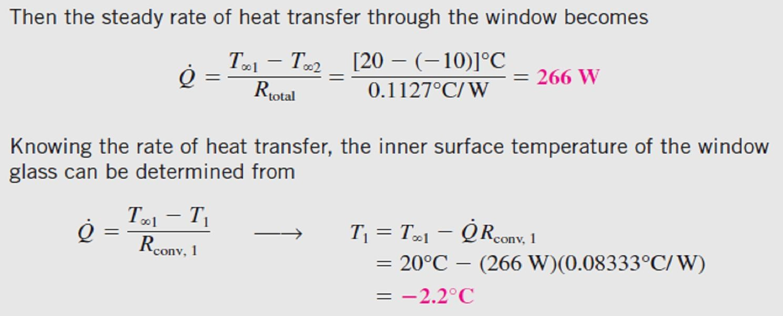
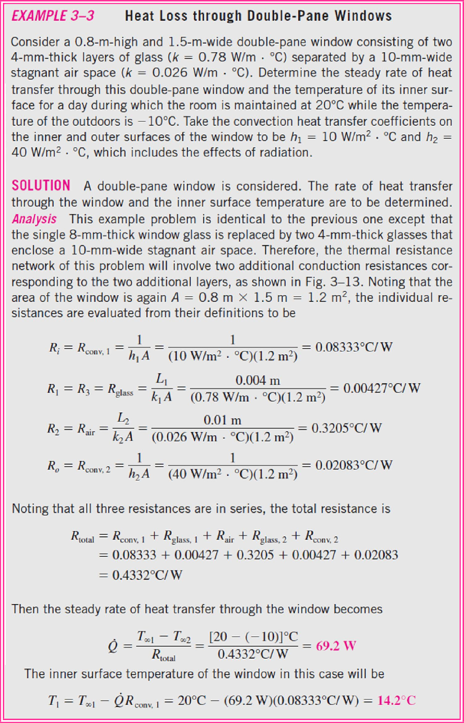
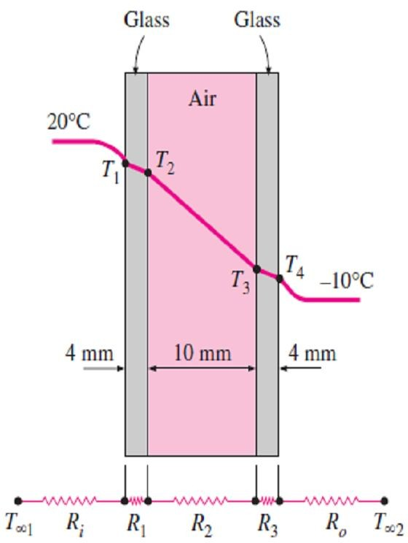
Chapter Three
Steady Heat Conduction
3.3-
Fig.(3.9).
Fig.(3.9) Schematic for Example- 3.3

Slide 7
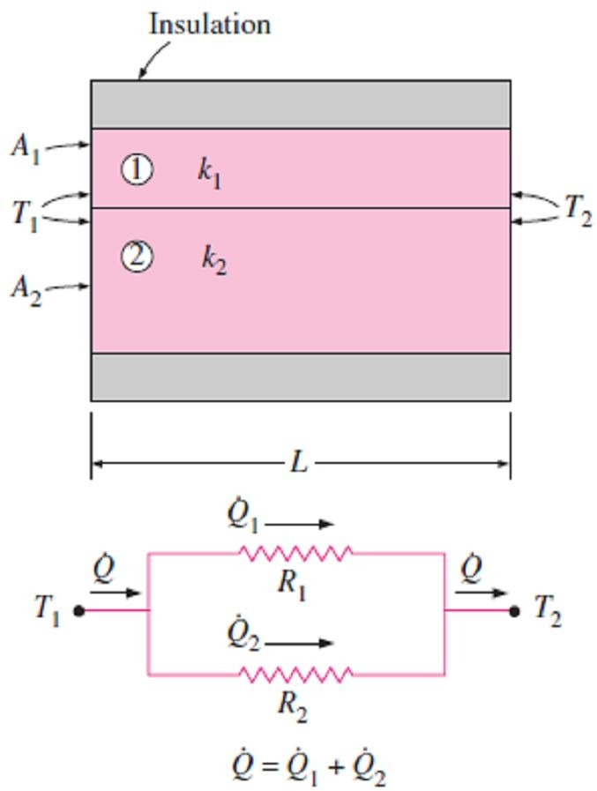
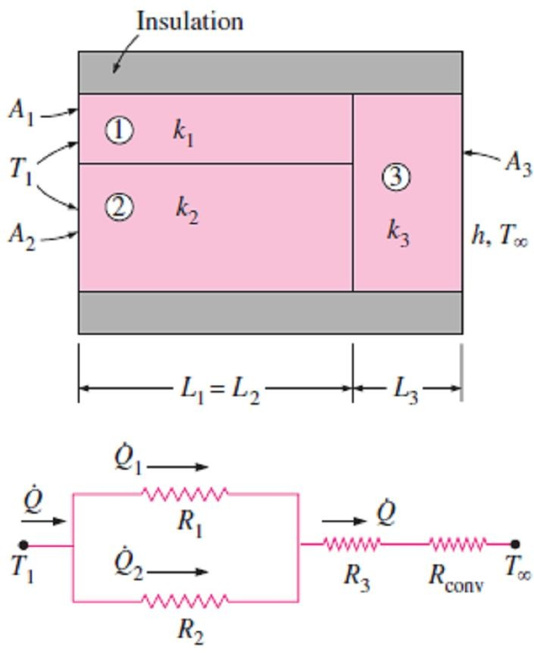
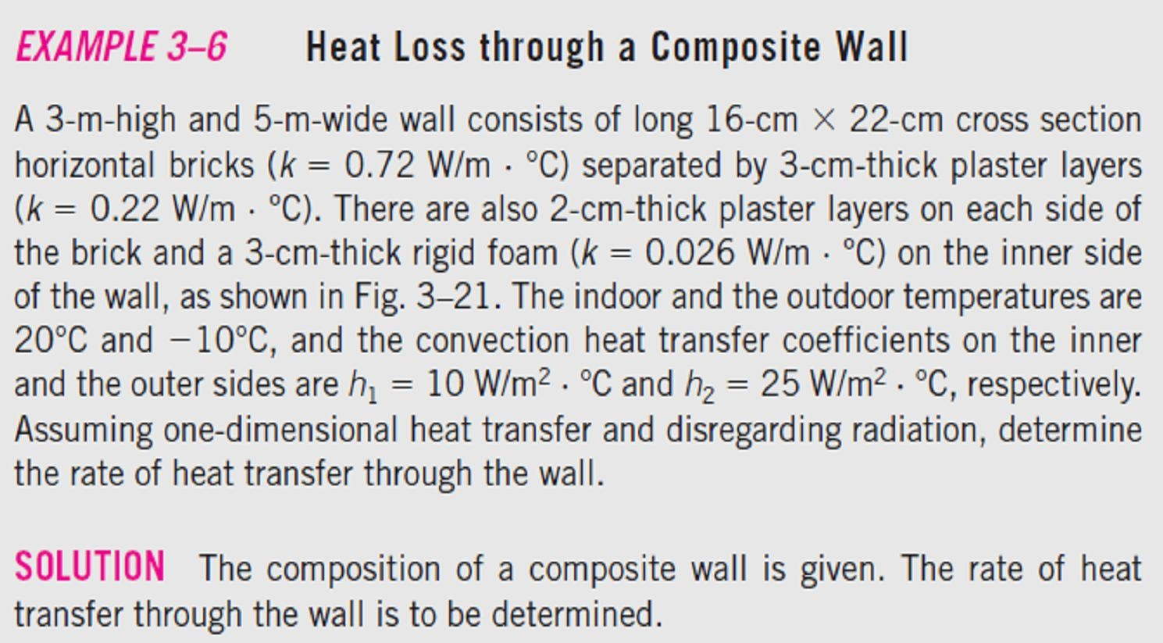
Chapter Three
Steady Heat Conduction
3.1.4- Generalized Thermal Resistance Networks The thermal resistance concept or the electrical analogy can also be used to solve steady heat transfer problems that involve parallel layers or combined series-parallel arrangements. Consider the composite wall shown in Fig.(3.10), which consists of two parallel layers. The thermal resistance network, which consists of two parallel resistances, can be represented as shown in the figure. Noting that the total heat transfer is the sum of the heat transfers through each layer, so, we have; Q = Q + Q = ^{T1 − T2} + ^{T1 − T2} 1 2 _{R R} 1 2 = (T − T ) ^{⎛ 1} + ^{1 ⎞} ☹ (3.13.a) ₁ ₂ ⎜ _{R R} ⎟ ⎝ 1 2 ⎠ By using electrical analogy, we get; Q = ^{T1 − T2} ☹ (3.13.b) ^{R}total where; ¹ = ¹ + ¹ → R = ^{R1R2} ☹(3.13.c) R R R ^{total} R + R total 1 2 1 2 Now consider the combined series-parallel arrangement shown in Fig.(3.11). The total rate of heat transfer through this composite system can again be expressed as; Q = ^{T1 − T∞} ☹ (3.14 .a ) ^{R}total where; ^{R}total ^{= R}12 ^{+ R}3 ^{+ R}conv = ^{R1 R2} + R + R ☹ (3.14 .b ) _{R + R} 3 conv 1 2 and; R = ^{L1} , R = ^{L2} , R = ^{L3} , R = ¹
1 | k₁ A₁ | ² k A 2 2 | 3 | k₃ A₃ | conv | hA₃
 | 3.4- | Fig.(3.12).
Fig.(3.10) Thermal resistance network for two parallel layers
Fig.(3.11) Thermal resistance network for combined series-parallel arrangement

Slide 8
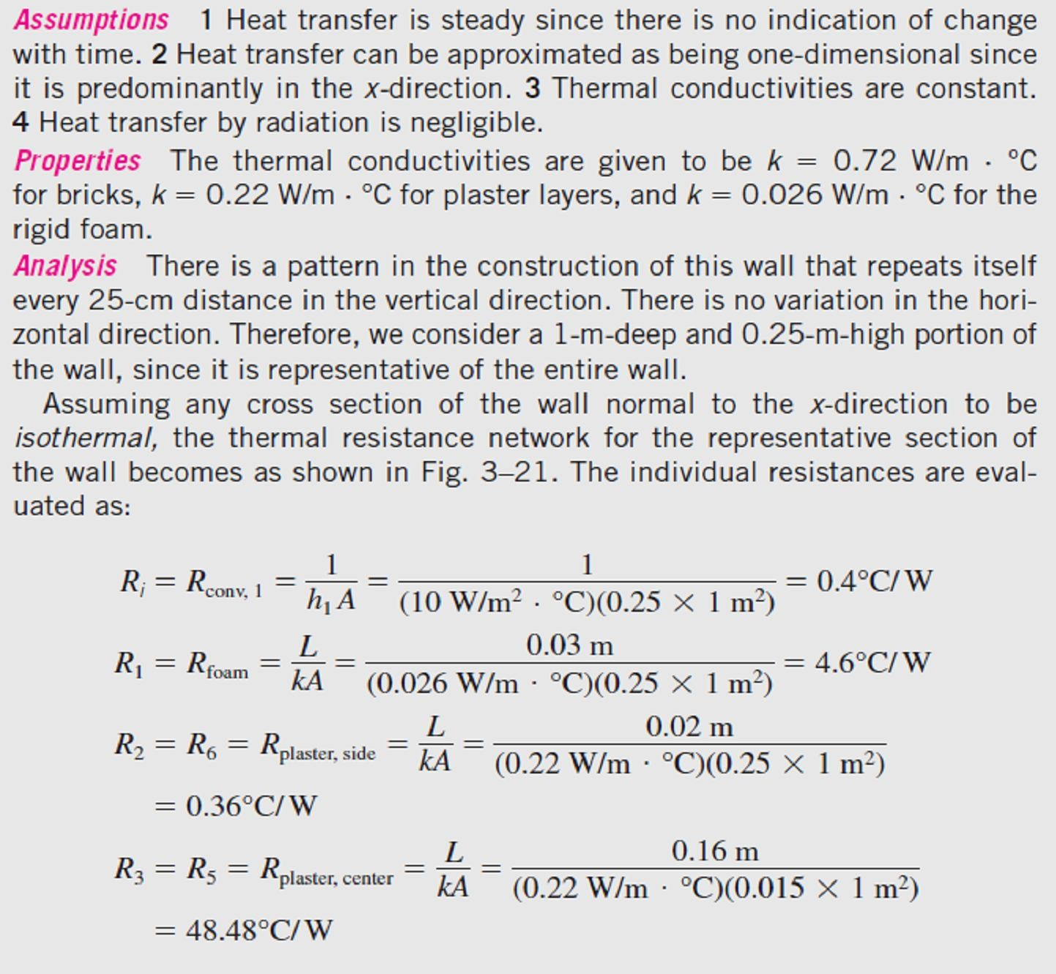
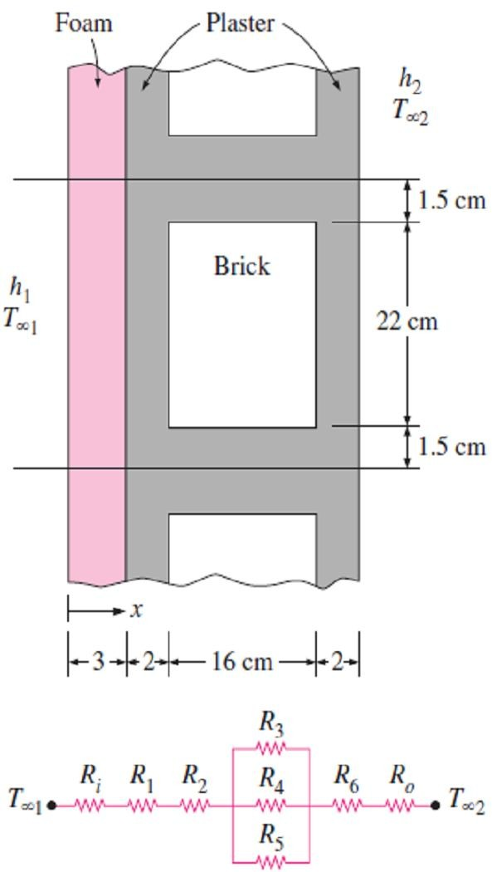
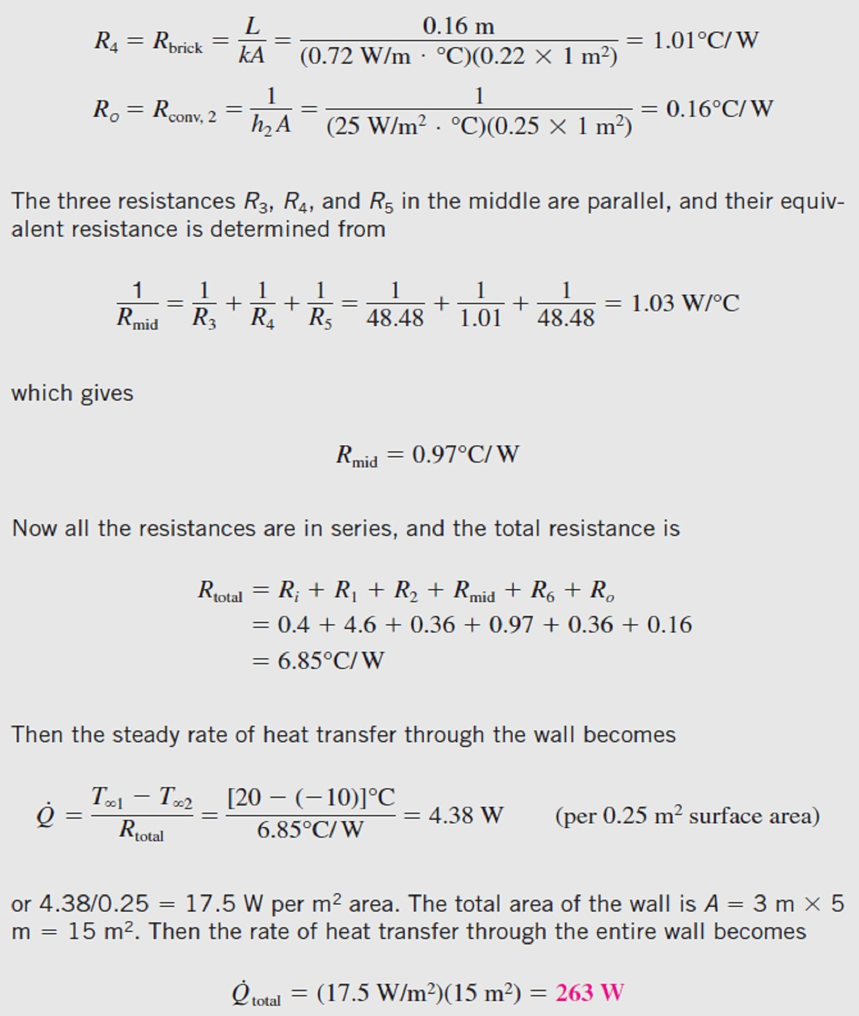
Chapter Three
Steady Heat Conduction
Fig.(3.12) Schematic for Example- 3.4
By Assistant Lecturer Ahmed N. Al- Musswy

Slide 9
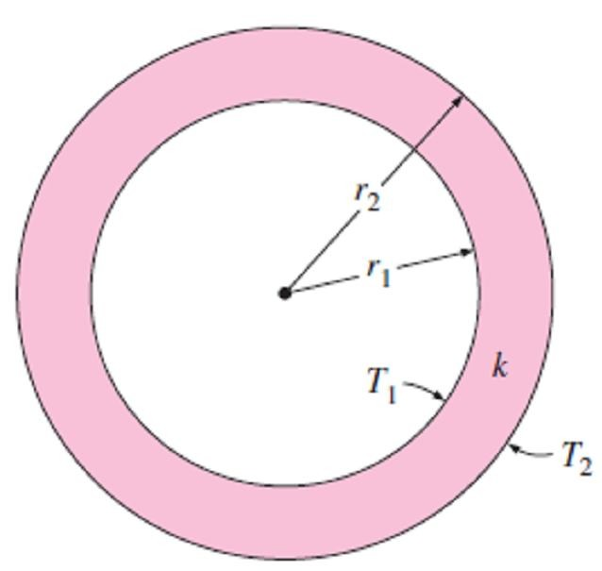
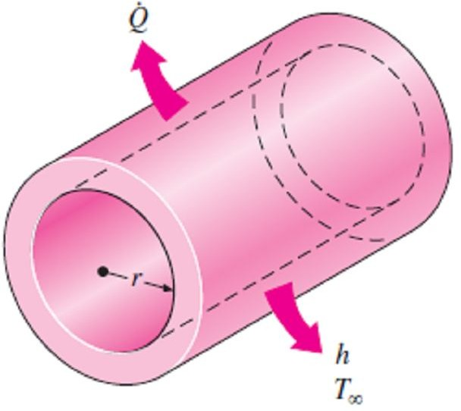
Chapter Three
Steady Heat Conduction
3.2- Steady Heat Conduction in Cylinders and Spheres 3.2.1- Single Layer Cylinders and Spheres
Consider a long cylindrical layer (such as a circular pipe) of inner
radius r₁, outer radius r₂, length L, and average thermal conductivity k as shown in Fig.(3.13). The two surfaces of the cylindrical layer are maintained at constant temperatures T₁ and T₂. There is no heat generation in the layer and the thermal conductivity is constant. For one-dimensional heat conduction through the cylindrical layer, we have T(r). Then Fourier’s law of heat conduction for heat transfer through the cylindrical layer can be expressed as;
_{Q}
cond, cyl
= −k A ^{dT} (W ) ☹(3.15.a)
dr
where A = 2πrL is the heat transfer area at location r. Note that A
Fig.(3.13) A long cylindrical pipe (or spherical shell) with specified inner and outer surface temperatures T₁ and T₂
depends on r, and thus it varies in the direction of heat transfer.
Separating the variables in the above equation and integrating from r =
r₁, where T(r₁) = T₁, to r = r₂, where T(r₂) = T₂, gives;

∫
r Q
cond , cyl
∫
T
2
2
r =r₁
A
dr = − k dT
☹ (3.15.b)
T =T₁
Substituting A = 2πrL and performing the integrations gives;
_{Q}
T₁ − T₂
cond , cyl
= 2L k (W ) ☹(3.16)
ln(r / r )
2 1
since Q_{cond,cyl} = constant. This equation can be rearranged as;
_{Q}
₌ T₁ − T₂
(W ) ☹(3.17.a)
cond, cyl
R
cyl
where;
₌ ln(r₂ / r₁ )
☹(3.17.a)
is the thermal resistance of the cylindrical layer against heat
R
cyl
2L k
(C □ / W )
conduction, or simply the conduction resistance of the cylinder layer. Note1- The wall of the pipe, whose thickness is rather small, separates two fluids at different temperatures as shown in Fig.(3.14), and thus
the temperature gradient in the radial direction will be relatively large.
Fig.(3.14) Heat is lost from a hot water pipe to the air outside in the radial direction, and thus heat transfer from a long pipe is one-dimensional
Thus heat transfer through the pipe can be modeled as steady and one-
dimensional. The temperature of the pipe in this case will depend on
one direction only (r-direction). This situation is approximated in
practice in long cylindrical pipes and spherical containers.
Note2- We can repeat the analysis above for a spherical layer by taking A = 4πr ² and performing the integrations in Eq.(3.15.b). The result can be expressed as;
_{Q}
= 4 r r k
T − T T − T
= (W ) ☹(3.18.a)
cond, sph
1 2
1 2 1 2
r − r R
where;
2 1
sph
R =
r₂ − r₁
(C □ / W ) ☹(3.18.b)
sph
4 r r k
1 2
is the thermal resistance of the spherical layer against heat conduction, or simply the conduction resistance of the spherical layer.

Slide 10
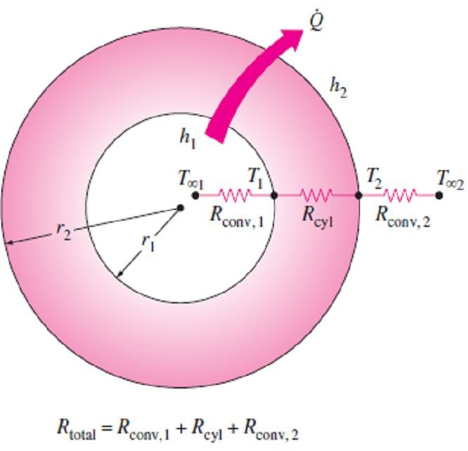
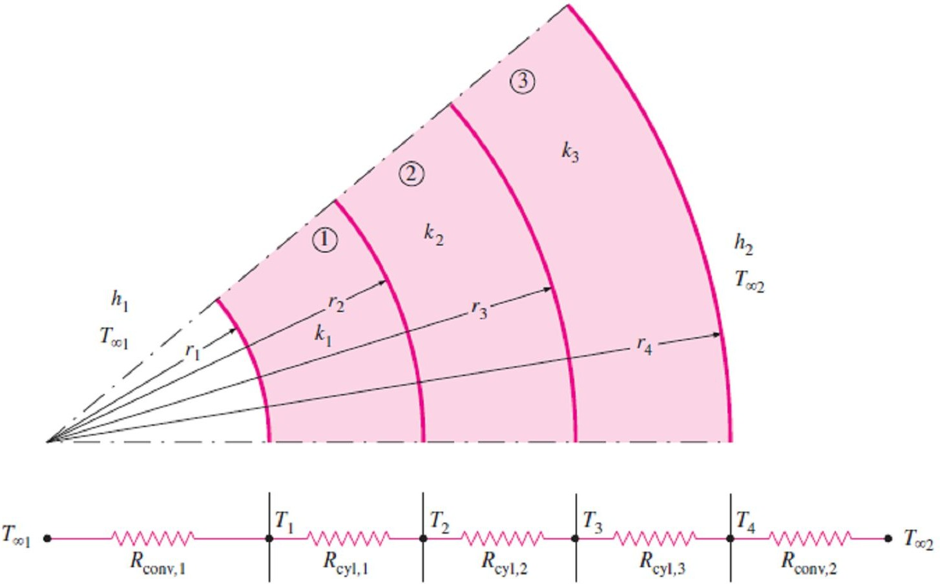
Chapter Three
Steady Heat Conduction
Note3- If we have a steady one-dimensional heat flow through a cylindrical or spherical layer that is exposed to convection on both sides to fluids at temperatures T_{∞1} & T_{∞2} with heat transfer coefficients h₁ & h₂, respectively, as shown in Fig.(3.15). The thermal resistance network in this case consists of one conduction and two convection resistances in series, just like the one for the plane wall, and the rate of heat transfer under steady conditions can be expressed as;
_{Q} ₌ ^{T}∞1 ^{− T}∞2
(W ) ☹(3.19.a)
^{R}total
where for a cylindrical layer;
^{R}total ^{= R}conv,1 ^{+ R}cyl ^{+ R}conv, 2
₌ 1 ₊ ln(r₂ / r₁ ) ₊ 1
☹(3.19.b)
Fig.(3.15) The thermal resistance network for a cylindrical
(or spherical) shell subjected to convection from both the inner
and the outer sides
(2 r₁L) h₁ 2L k
and for a spherical layer;
^{R}total ^{= R}conv,1 ^{+ R} sph ^{+ R}conv, 2
(2 r₂ L) h₂
₌ 1 ₊ r₂ − r₁ ₊ 1
☹(3.19.c)
(4 r ² ) h 4 r r k (4 r ² ) h
1 1 1 2 2 2
Note that A in the convection resistance relation R_{conv} = 1/(hA) is the surface area at which convection occurs. It is equal to A = 2πrL for a cylindrical surface and A = 4πr ² for a spherical surface of radius r. Also note that the thermal resistances are in series, and thus the total thermal resistance is determined by simply adding the individual resistances.
3.2.2- Multilayered Cylinders and Spheres
Steady heat transfer through multilayered cylindrical or spherical shells can be handled just like multilayered plane walls which were discussed earlier simply by adding an additional resistance in series for each additional layer. For example, the steady heat transfer rate through the three-layered composite cylinder of length L shown in Fig.(3.16) with convection on both sides can be expressed as;
_{Q} ₌ ^{T}∞1 ^{− T}∞2
(W ) ☹(3.20.a)
^{R}total
Fig.(3.16) The thermal resistance network for heat transfer through a three-layered composite cylinder subjected to convection on both sides

Slide 11
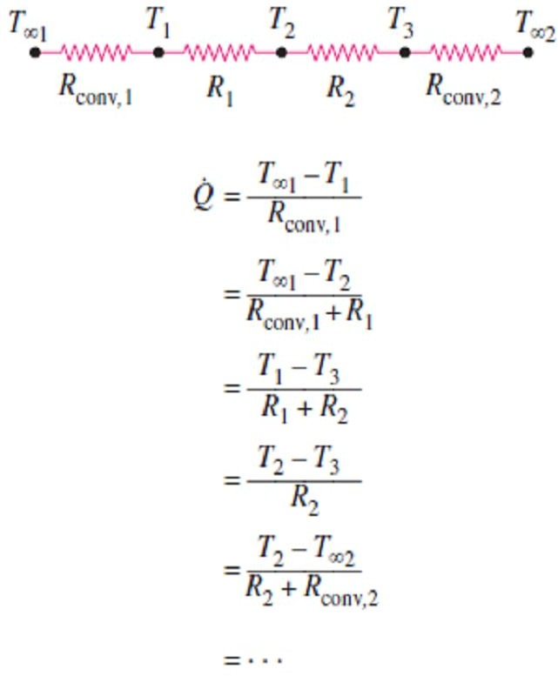
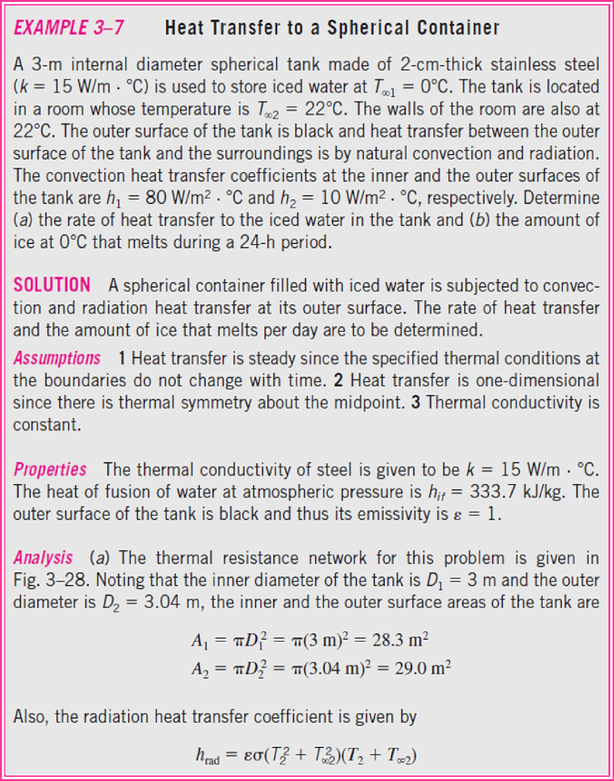
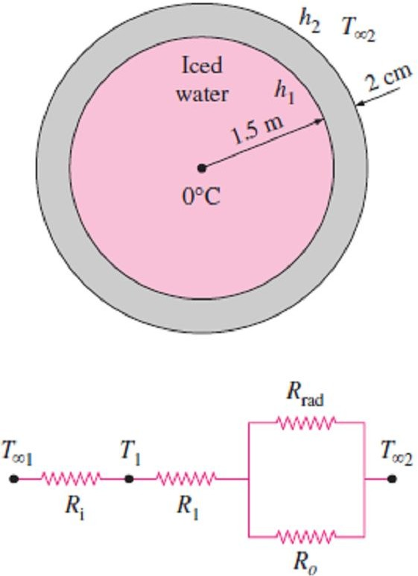
Chapter Three
Steady Heat Conduction
where R_{total} is the total thermal resistance, expressed as; ^{R}total ^{= R}conv,1 ^{+ R}cyl,1 ^{+ R}cyl, 2 ^{+ R}cyl,3 ^{+ R}conv, 2 ₌ 1 ₊ ln(r₂ / r₁ ) ₊ ln(r₃ / r₂ ) ₊ ln(r₄ / r₃ ) ₊ 1 h₁ A₁ 2L k₁ 2L k₂ 2L k₃ h₂ A₄ ☹(3.19.b) where A₁ = (2π r₁ L) and A₄ = (2π r₄ L). Note1- Equation (3.19.b) can also be used for a three-layered spherical shell by replacing the thermal resistances of cylindrical layers by the corresponding spherical ones. Note2- If Q is known, we can determine any intermediate temperature T_{j} by applying the relation Q = (T_{i} −T_{j} ) / R_{total, i− j} across any layer or layers such that T_{i} is a known temperature at location i and R_{total, i- j} is the total thermal resistance between locations i and j as shown in Fig.(3.17).
 | Fig.(3.17) The ratio ΔT/R across any layer is equal to Q which remains constant in one-dimensional steady conduction
3.5-
Fig.(3.18) Schematic for Example- 3.5
Fig.(3.18).

Slide 12
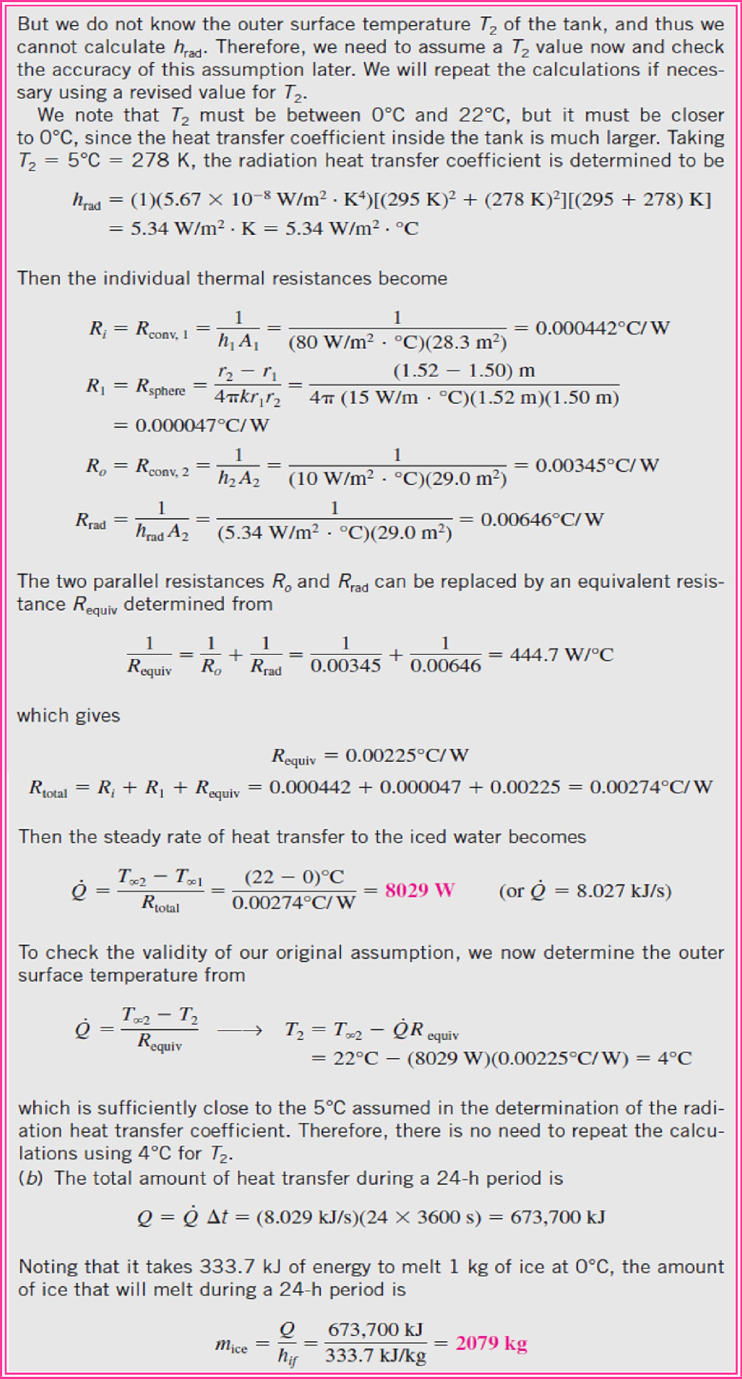
Chapter Three
Steady Heat Conduction

Slide 13
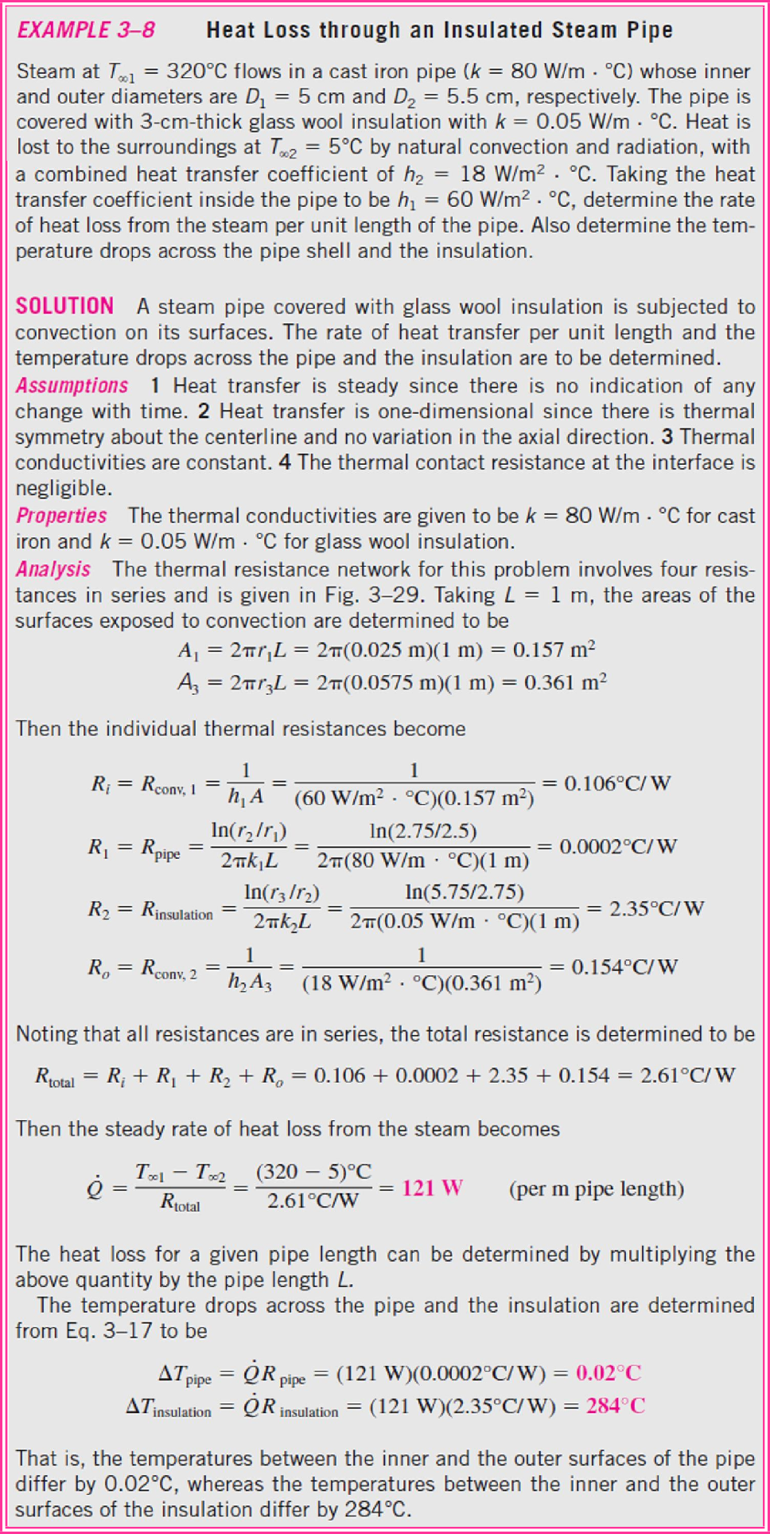
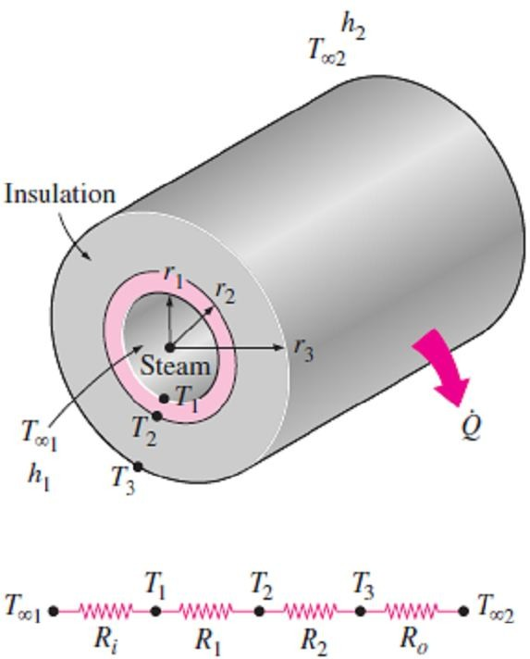
Chapter Three
Steady Heat Conduction
3.6-
Fig.(3.19) Schematic for Example- 3.6
Fig.(3.19).

Slide 14
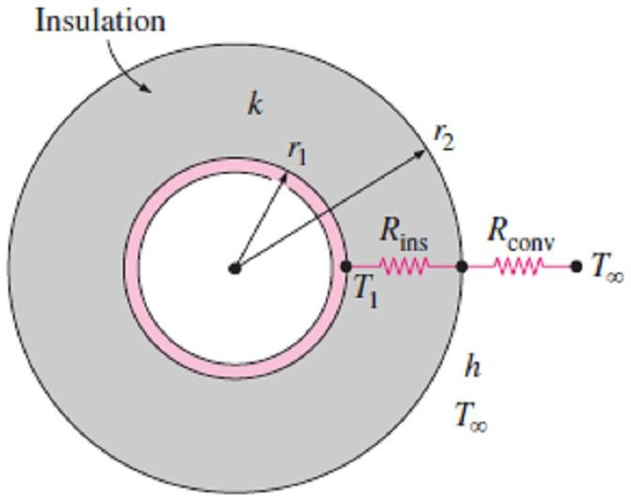
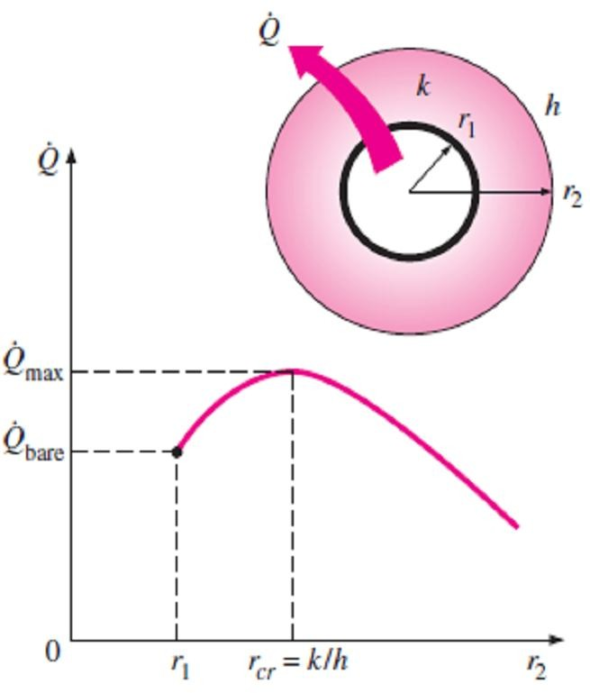
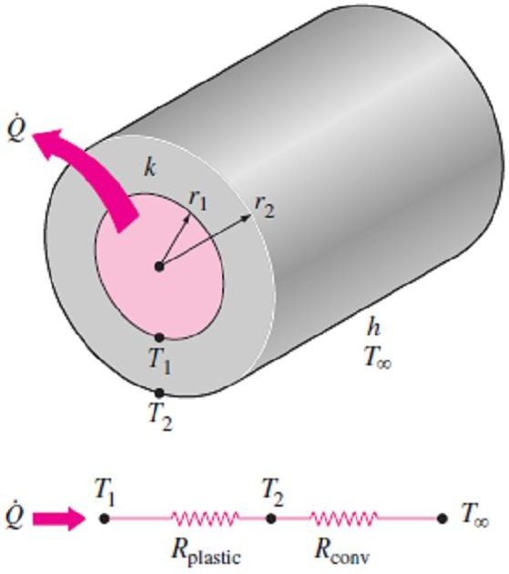
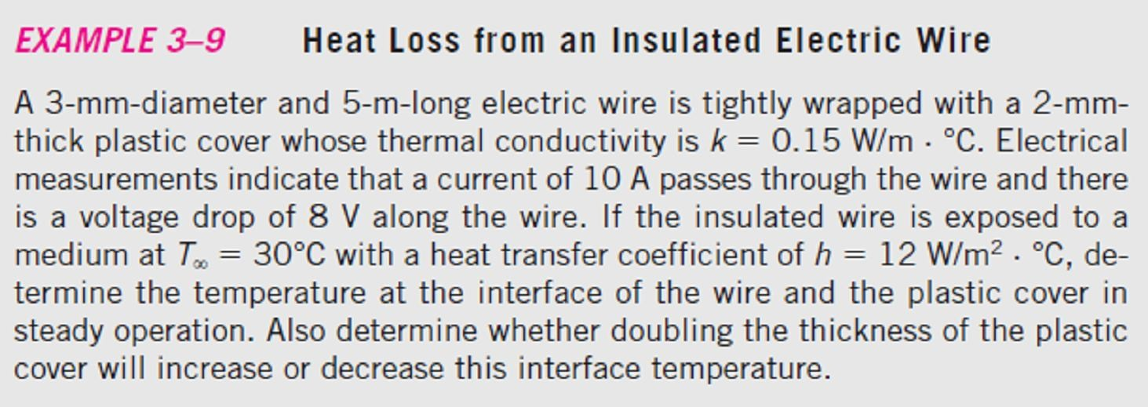
Chapter Three
Steady Heat Conduction
3.2.3- Critical Radius Of Insulation
Adding more insulation for a plane wall always increases the thermal resistance of that wall without increasing the convection resistance since the heat transfer area A is constant. But adding insulation to a cylindrical pipe or a spherical shell, however, is a different matter. The additional insulation increases the conduction resistance of the insulation layer but decreases the convection resistance of the surface because of the increase in the outer surface area for convection. The heat transfer from the pipe may increase or decrease, depending on which effect will dominate. Consider a cylindrical pipe of outer radius r₁ whose outer surface temperature T₁ is maintained constant as in Fig.(3.20). The pipe is now insulated with a material whose thermal conductivity is k and outer radius is r₂. Heat is lost from the pipe to the surrounding medium at temperature T∞, with a convection heat transfer coefficient h. The rate of heat transfer from the insulated pipe to the surrounding air
can be expressed as;
T₁ − T∞ T₁ − T∞
Fig.(3.20) An insulated cylindrical pipe exposed to convection from the outer surface and the thermal resistance network associated with it
Q =
= ☹(3.20)
R + R
ln(r₂ / r₁ ) 1 2L k h (2 r₂ L)
ins conv
+
The variation of Q with the outer radius of the insulation r₂ is plotted in Fig.(3.21). The value of r₂ at which Q reaches a maximum value is determined from the requirement that dQ / dr₂ = 0 (zero slope), where performing that differentiation and solving for r₂
yields the critical radius of insulation for a cylindrical body to be;
r
₌ k
(m) ☹(3.21.a)
cr , cylinder
h
Note1- The discussions above can be repeated for a sphere, where the critical radius of insulation for a spherical shell is;
r
₌ 2k
(m) ☹(3.21.b)
cr , sphere
h
Note2- As it is clear from both equations above, the critical radius of
Fig.(3.21) The variation of heat transfer rate with the outer radius of the insulation r₂
insulation depends on the thermal conductivity of the insulation k
and the external convection heat transfer coefficient h.
Note3- The rate of heat transfer from the cylinder increases with the addition of insulation for r₂ < r_{cr}, and reaches its maximum value when r₂ = r_{cr}, after that starts to decrease for r₂ > r_{cr}. Thus, insulating the pipe may actually increase the rate of heat transfer from the pipe instead of decreasing it when r₂ < r_{cr}.
3.7-
Fig.(3.22) Schematic for Example- 3.7

Slide 15
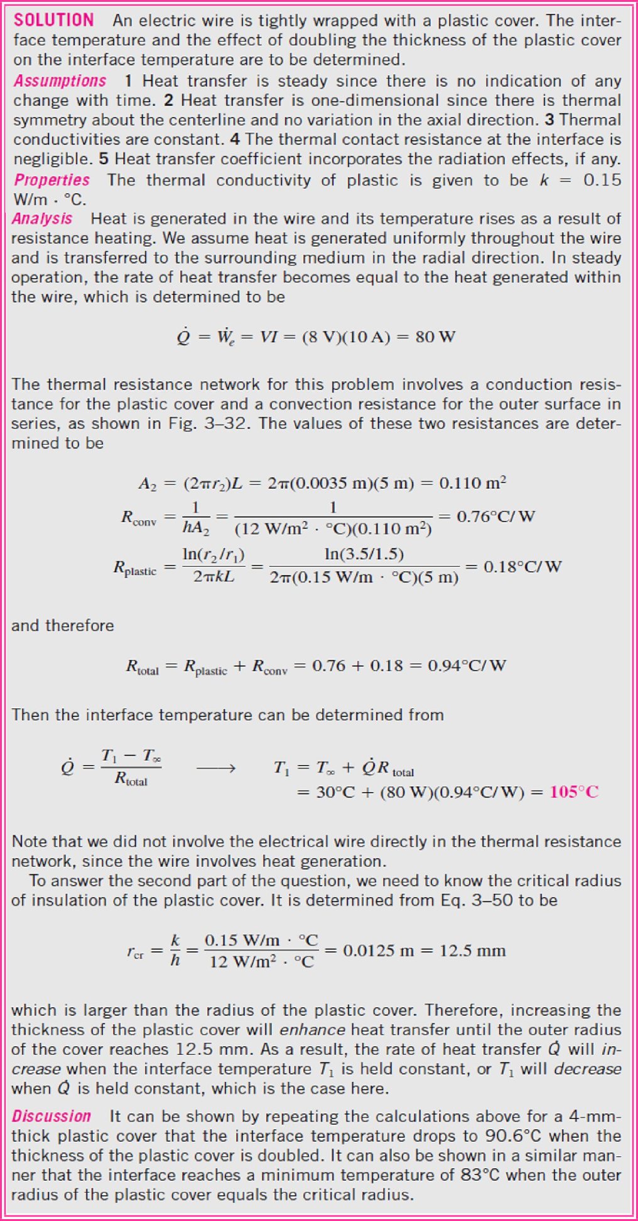
Chapter Three
Steady Heat Conduction
Fig.(3.22).

Slide 16
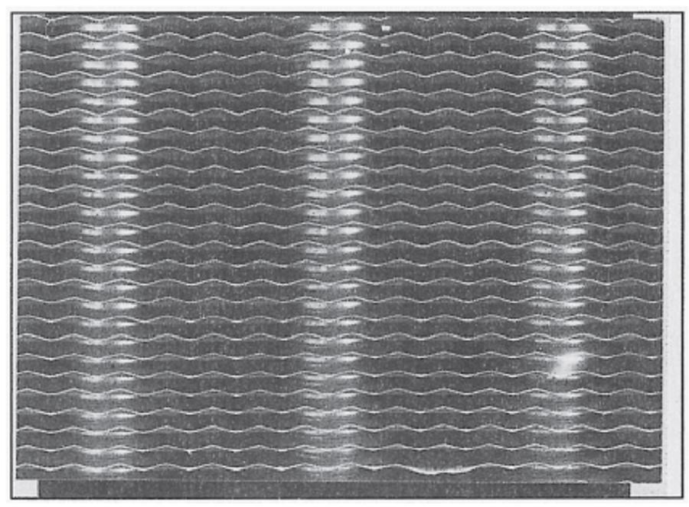
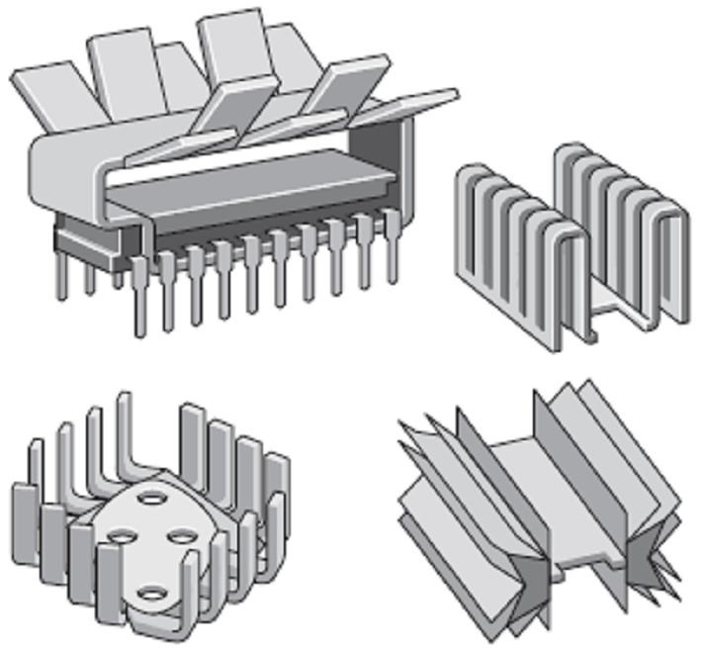
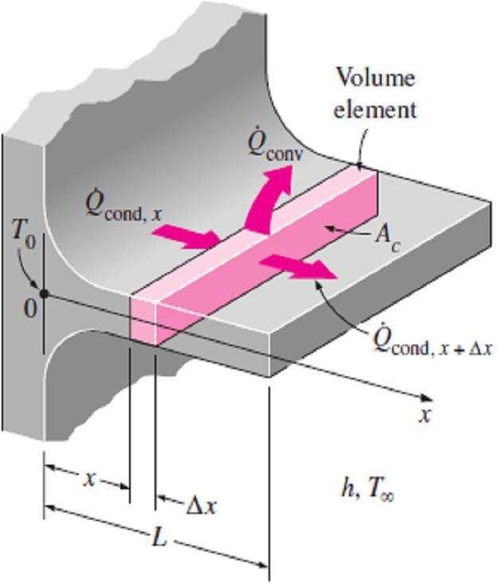
Chapter Three Steady Heat Conduction
3.3- Heat Transfer from Finned Surfaces
The rate of heat transfer from a surface at a temperature T_{s} to the surrounding medium at T∞ is
given by Newton’s law of cooling as; Q_{conv} = hA_{s} (T_{s} −T∞ ) , where A_{s} is the heat transfer surface area and h is the convection heat transfer coefficient. When the temperatures T_{s} and T∞ are fixed by design
considerations. So, there are two ways to increase the rate of heat transfer; to increase the convection
heat transfer coefficient h or to increase the surface area A_{s}. Increasing h may require the installation of a pump or fan, or replacing the existing one with a larger one, but this approach may or may not be practical. Besides, it may not be too effective. The alternative is to increase the surface area by attaching to the surface extended surfaces called fins made of highly conductive materials such as aluminum. Fins increase heat transfer from a surface by providing a larger surface area to convection and radiation as in the car radiator shown in Fig.(3.23), also There are a variety of fin designs is available as shown in Fig.(3.24).
Fig.(3.23) The thin plate fins of a car radiator greatly increase the rate of heat transfer to the air
Fig.(3.24) Some special fin designs
3.3.1- Fin Equation
Consider a volume element of a fin at location x having a length of Δx, cross-sectional area of A_{c}, and a perimeter of p, as shown in Fig.(3.25). Under steady conditions, the energy balance on this volume element can be expressed as;
⎛ Rate of heat ⎞ ⎛ Rate of heat
⎞ ⎛ Rate of heat ⎞
⎜
⎟ ⎜
⎟ ⎜ ⎟
⎜ conduction into ⎟ = ⎜ conduction from the ⎟ + ⎜ convection from ⎟
⎜ the element at x ⎟ ⎜ element at x + Δx
⎟ ⎜
the element
⎟
or;
⎝ ⎠ ⎝
⎠ ⎝
⎠
^{Q} cond , x ^{= Q}cond , x+Δx ^{+ Q}conv
☹(3.20)
where;
Q_{conv} = h A_{s} (T − T∞ ) = h( p Δx)(T − T∞ ) ☹(3.21)
Substituting Eq.(3.21) into Eq.(3.21) and dividing by Δx, we obtain;
 
Q
Q
Fig.(3.25) Volume element of a fin at location x having a length of Δx, cross-sectional area of A_{c},
and perimeter of p
cond , x+Δx cond , x
+ h p(T − T∞ ) = 0 ☹(3.22.a)
Δx
Taking the limit as Δx 0 gives;

dQ
cond
+ h p(T − T ) = 0 ☹(3.22.b)
dx
∞
From Fourier’s law of heat conduction we have;
_{Q}
cond
= −k A ^{dT} ☹(3.22.c)
^{c} dx

Slide 17
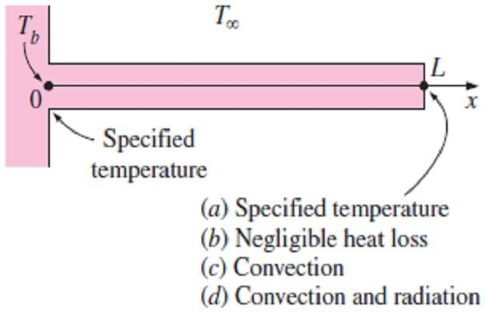
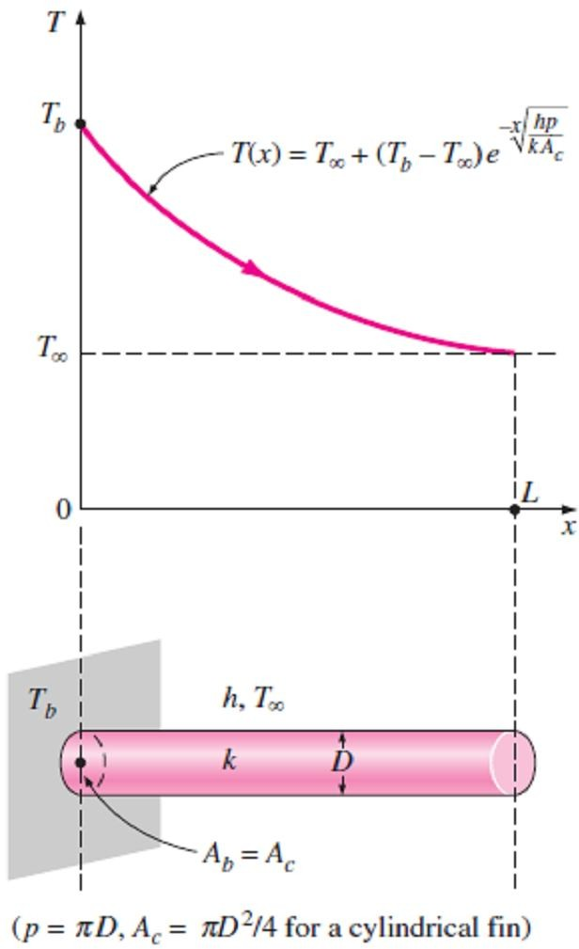
Chapter Three Steady Heat Conduction
where A_{c} is the cross-sectional area of the fin at location x. Substitution of this relation into Eq.(3.22.b) gives the differential equation governing heat transfer in fins as follow;
^{d ⎛} k A ^{dT ⎞} − h p(T − T ) = 0 ☹(3.23)
dx ⎜
c
dx
⎟
∞
⎝ ⎠
Note- In general, the cross-sectional area A_{c} and the perimeter p of a fin vary with x, which makes this differential equation too difficult to solve. In the special case of constant cross section and constant thermal conductivity, the differential equation (3.23) reduces to;
d ² ₋
a  = 0 ☹(3.24.a)
dx²
2
where;
_{a2 =} h p
k A_{c}
☹(3.24.b)
and θ = T -T∞ is the temperature excess.
Eq.(3.24.a) is a linear, homogeneous, 2nd order differential equation with constant coefficients, Therefore, the general solution of that equation will be as follow;
❑ (x) = C e^{a x} + C e^{− a x} ☹(3.25)
1 2
where C₁ and C₂ are arbitrary constants whose values are to be determined from the boundary conditions at the base and at the tip of the fin.
3.3.2- Fin Boundary Conditions
As it is clear from Eq.(3.25), we need only two conditions to determine C₁ and C₂, and these two conditions are located at;
1- Boundary condition at fin base:
The temperature of the plate to which the fins are attached is normally called as the fin base temperature and its value is usually known, where T= T_{b}, Therefore, at the fin base we have a specified temperature boundary condition, expressed as;
❑ (0) =  = T − T ☹(3.26)
Fig.(3.26) Boundary conditions at the fin base and the fin tip
b b ∞
2- Boundary condition at fin tip
At the fin tip we have several possibilities, including specified temperature, negligible heat loss, convection, and combined convection and radiation as shown in Fig.(3.26). Next, we consider each case separately.
3.3.2.1- Infinitely Long Fin (T _{tip} = T∞)
For a sufficiently long fin of uniform cross section (A_{c} = constant), the temperature of the fin at the fin tip will approach the environment
temperature T∞ and thus θ will approach zero. That is;
❑ (L) = T (L) −T∞ ≈ T∞ −T∞ ≈ 0, as; L → ∞
By applying these conditions into Eq.(3.25), we get; B.C.1- At x=L=∞, θ=0  0=C₁(∞)+C₂(0)  C₁=0. B.C.2- At x=0, θ=θ_{b}  θ_{b} = C₂(1)  C₂=1.
Thus, the required solution for this case is;
☹(3.27.a)
(x) = e^{−ax} ⇒
^{T(x) −T}∞ _{= e}−ax _{= e}−x h p /(k A_{c} )
☹(3.27.b)
b
T −T
b ∞
Note1- The temperature along the fin in this case will decrease
Fig.(3.27) A long circular fin of uniform cross-section
exponentially from T_{b} to T∞, as shown in Fig.(3.27).

Slide 18
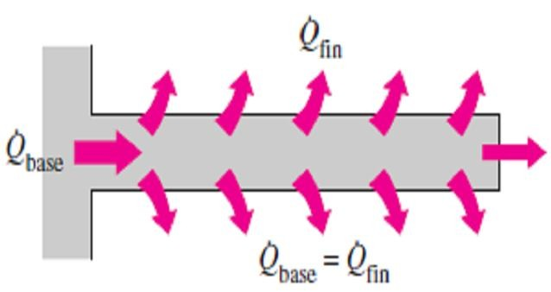
Chapter Three
Steady Heat Conduction
Note2- The steady rate of heat transfer from the entire fin can be determined by applying Fourier’s law of heat conduction at the fin base as follow;
_{Q}
long fin
= −k A ^{dT} = h pk A (T − T ) ☹(3.27.c)
^{c} dx
x=0
c b ∞
Note3- The rate of heat transfer from the fin could also be determined by
Fig.(3.28) Under steady conditions, heat transfer from the exposed surfaces of the fin is equal to heat conduction
to the fin at the base
considering heat transfer from a differential volume element of the fin
and integrating it over the entire surface of the fin. That is,
_{Q}
fin
= ∫ h[T (x) − T ]dA = ∫ h (x) dA
A
∞ fin fin
A
fin fin
∫
L
= h (x)( pdx)
☹(3.28)
x=0
The two approaches described above are equivalent and give the same result since, under steady conditions, the heat transfer from the exposed surfaces of the fin is equal to the heat transfer to the fin at the base as shown in Fig.(3.28).
3.3.2.2- Negligible Heat Loss from the Fin Tip (Insulated fin tip, Q _{fintip} = 0 )
Fins are not likely to be so long that their temperature approaches the surrounding temperature at the tip. A more realistic situation is for heat transfer from the fin tip to be negligible since the heat transfer from the fin is proportional to its surface area, and the surface area of the fin tip is usually a negligible fraction of the total fin area. Then the fin tip can be assumed to be insulated, and the condition at the fin tip can be expressed as;
d
= 0 ☹(3.29)
^{dx} x =L
where the condition at the fin base remains the same as expressed in Eq.(3.26). The application of these two conditions on the general solution Eq.(3.25) yields;
B.C.1- At x = 0,  = _{b} → _{b} = C₁ (1) + C₂ (1) → C₁ + C₂ = _{b}
B.C.2- At x = L, ^{d} = 0 → 0 = aC e^{aL} − aC e^{−aL} → C = C e^{2aL}
dx
1 2 1 2
Thus, by solving above two equations, we get;
C =
_{b}
_{1+ e}2aL
& C =
_{b}
_{e}−2aL ₊₁
, So the total solution will be;
1
2
❑ (x) ₌
_{e}ax _{e}− ax
+
❑
b
_{1 + e}2aL _{e}−2aL ₊ ₁
_{e}−aL _{e}aL
st nd
By multiplying the 1 term of above equation by and the 2 by respectively, we have;
_{e}−aL _{e}aL
❑ (x) ₌
_{e}ax_{e}− aL _{e}− ax_{e}aL _{= e}− a ( L− x) _{+ e}a( L− x )
+
❑
b
_{e}−aL _{+ e}aL _{e}−aL _{+ e}aL _{e}−aL _{+ e}aL
Thus, the final solution for insulated fin tip will be as follow;
T (x) − T_{∞ =} cosh a(L − x)
(3.30)
T_{b} − T∞ cosh aL
The rate of heat transfer from the fin can be determined again from Fourier’s law as follow;
_{Q}
insulated tip
= −k A ^{dT} = h pk A (T − T ) tanh aL ☹(3.31)
^{c} dx
x=0
c b ∞

Slide 19
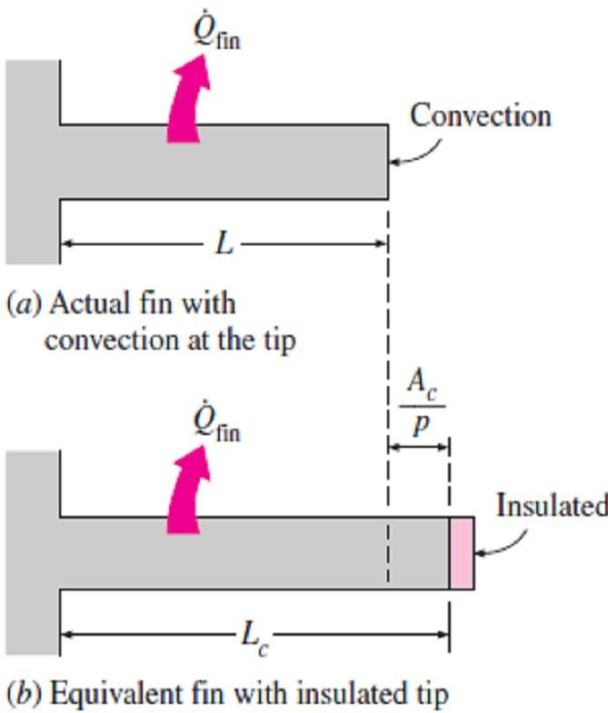
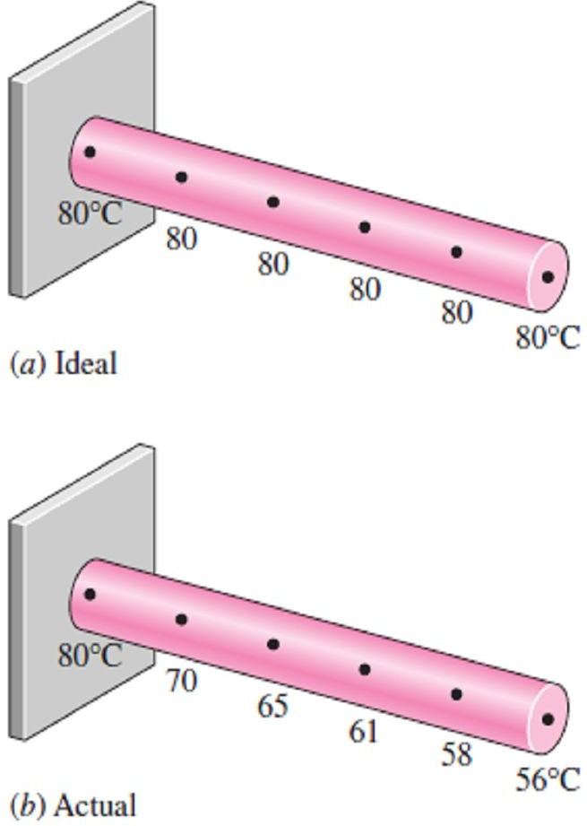
Chapter Three
Steady Heat Conduction
3.3.2.3- Convection (or Combined Convection and Radiation) from Fin Tip
The fin tips, in practice, are exposed to the surroundings, and thus
the proper boundary condition for the fin tip is convection that also includes the effects of radiation. In general, the fin tip area is a small fraction of the total fin surface area, and thus we'll simplify the problem heat loss from the fin tip [as shown in Fig.3.29)] by replacing the fin length L in the relation for the insulated tip case by
a corrected length L_{c} which is defined as;
A
L = L +
c
p
☹(3.32)
c
where A_{c} is the cross-sectional area and p is the perimeter of the fin at the tip.
Note- By using the proper relations for A_{c} and p, the corrected lengths for rectangular and cylindrical fins are determined to be;
L = L + ^{t ⎫}
Fig.(3.29) Corrected fin length L is
c, rec tan gular fin
₂ ⎪
c
⎬
☹(3.33)
defined such that heat transfer from a fin of length L_{c} with insulated tip is equal to heat transfer from the actual fin of length L with convection at the fin tip
L = L + ^{D ⎪}
c, cylindrica l fin
4 ⎪⎭
where t is the thickness of the rectangular fins and D is the diameter of the cylindrical fins.
3.3.3- Fin Efficiency
In general, the fin base temperature T_{b} gradually decreases toward the fin tip, but in an ideal case of zero thermal resistance or infinite thermal conductivity (k → ∞), the temperature of the fin will be uniform at the base value of T_{b} as in Fig.(3.30). So, the heat transfer from the fin will be maximum in this case and can be expressed as;
^{Q} fin, max ^{= h A}fin ^{(T}b ^{− T}∞ ⁾
☹(3.34)
In reality, the temperature of the fin T(x) will drop along the fin, and thus the heat transfer from the fin will be less because of the decreasing in temperature difference T(x)–T_{b} toward the fin tip, as shown in Fig.(3.30). To account for the effect of this decrease in temperature on heat transfer, we define a fin efficiency as;
 =
_{Q}
^{Q} fin
₌ Actual heat transfer rate from the fin
fin
⎛ Ideal heat transfer rate from the fin if ⎞
fin, max
⎜ ⎟
⎝ the entire fin were at base temperatur e ⎠
or;
☹(3.35)
Fig.(3.30) Ideal and actual temperature distribution in a fin
^{Q} fin ^{= } fin ^{Q} fin, max ^{= } fin ^{h A}fin ^{(T}b ^{− T}∞ ⁾
where A_{fin} = A_{fin (lateral)} + A_{tip} is the total surface area of the fin.
Note1- For the cases of constant cross section (A_{fin}= pL) of very long fins and fins with insulated tips,
the fin efficiency can be expressed as;

₌ ^{Q}long fin
=
h p k A_{c} (T_{b} − T∞ ) ₌ 1
k A_{c =} 1
(3.36.a)
long fin
_{Q}
fin, max
h A (T − T ) L h p a L
fin b ∞

₌ ^{Q}insulated tip
=
h p k A_{c} (T_{b} − T∞ ) tanh aL ₌ tanh aL
(3.36.b)
insulated tip
_{Q}
fin, max
h A_{fin} (T_{b} − T∞ ) a L

Slide 20
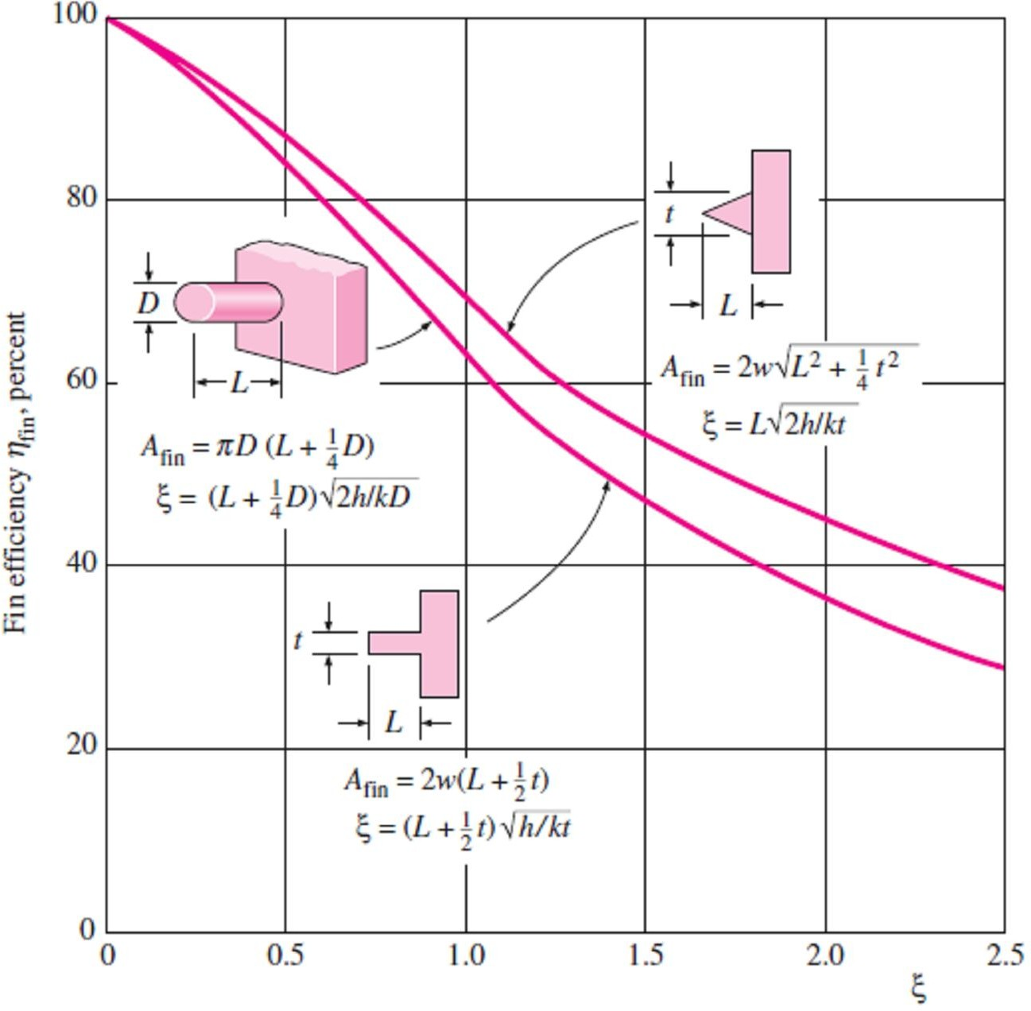
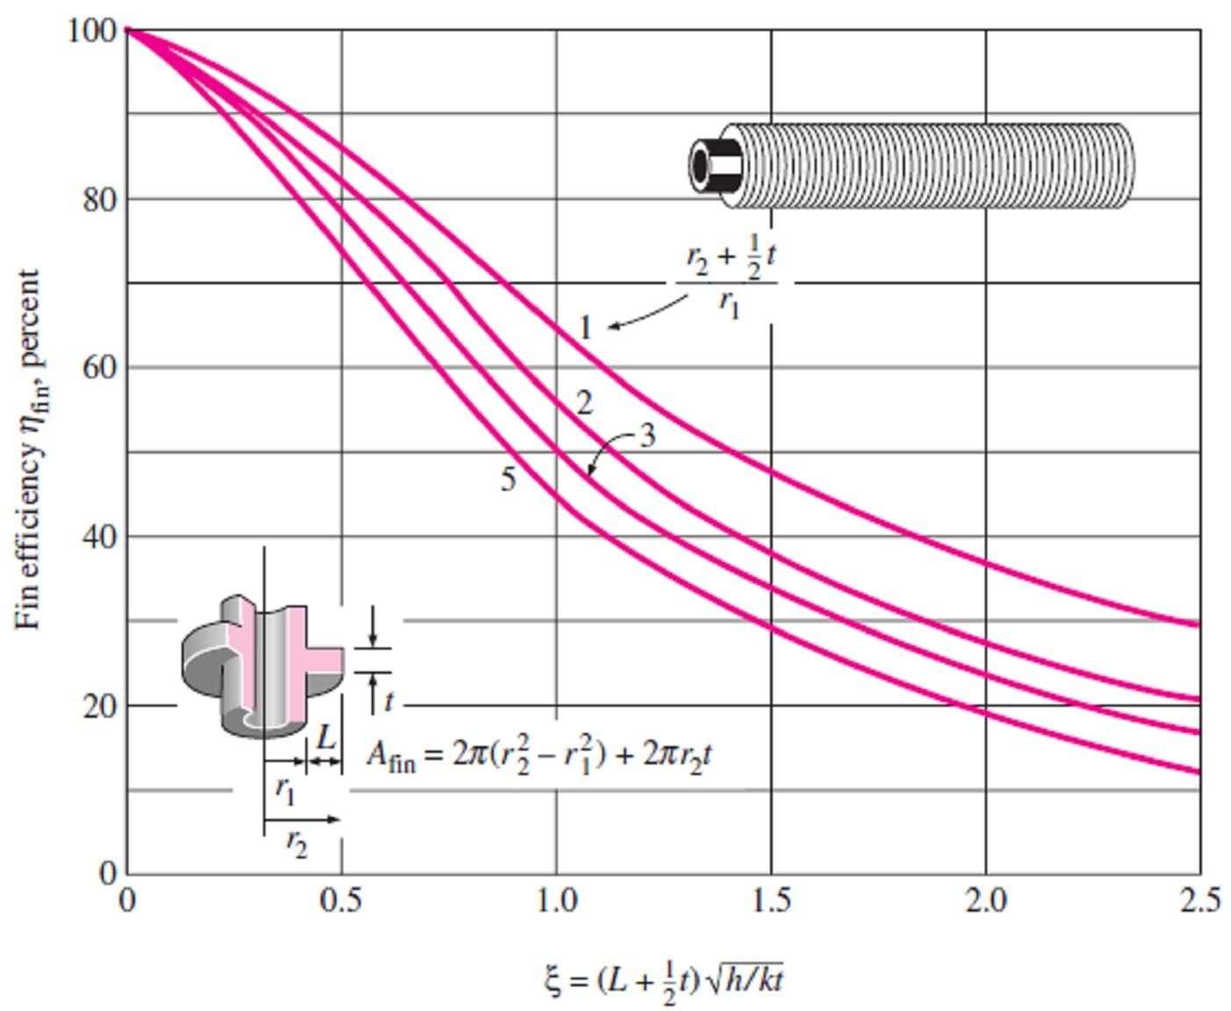
Chapter Three Steady Heat Conduction
Note2- Eq.(3.36.b) can also be used for fins which are subjected to convection by replacing the fin length L by the corrected length L_{c} as follow;

₌ ^{Q} convective tip ₌
h p k A_{c} (T_{b} − T∞ ) tanh aL_{c =} tanh aL_{c}
(3.36.c)
convective tip
_{Q}
h A_{fin} (T_{b} − T∞ ) a L
fin, max c
Note3- Fin efficiency relations are developed for fins of various profiles and are plotted in Fig.(3.31) for fins on a plain surface and in Fig.(3.32) for circular fins of constant thickness. The fin surface area associated with each profile is also given on each figure. For most fins of constant thickness encountered in practice, the fin thickness t is too small relative to the fin length L, and thus, the fin tip area is negligible.
Fig.(3.31) Efficiency of circular, rectangular, and triangular fins on a plain surface of width w
Fig.(3.32) Efficiency of circular fins of length L and constant thickness t

Slide 21
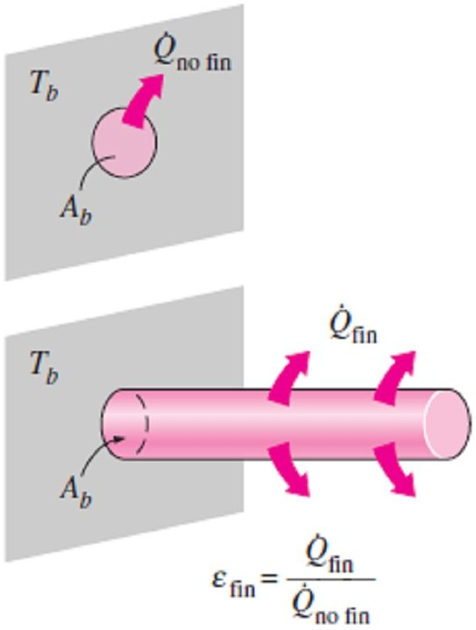
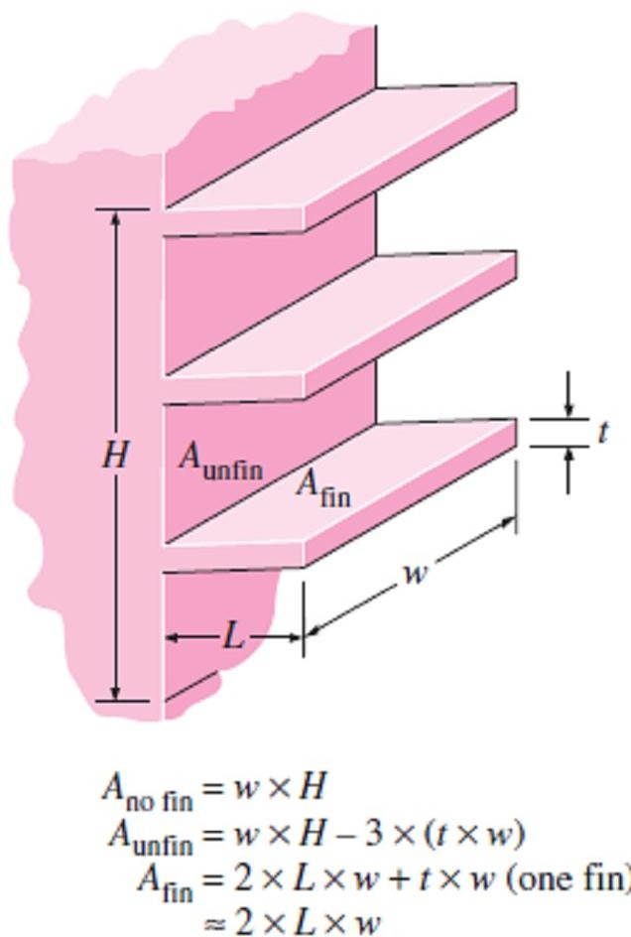
Chapter Three
Steady Heat Conduction
3.3.4- Fin Effectiveness
The performance of the fins is estimated on the basis of the enhancement in heat transfer relative to the no-fin case. The performance of fins as shown in Fig.(3.33) is expressed in terms of the fin effectiveness ε_{fin} which is defined as;
⎛ Heat transfer rate from ⎞
_{Q}
⎜ ⎟
the fin of base area A

₌ fin ₌ ⎝ b ⎠
☹(3.37)
fin
_{Q}
⎛ Heat transfer rate from ⎞
no fin
⎜
⎝
⎟
the surface of area A_{b ⎠}
where A_{b} is the cross-sectional area of the fin at the base and Q _{no fin}
represents the rate of heat transfer from this area if no fins are attached to the surface. However, the use of fins cannot be justified unless ε_{fin} is sufficiently larger than 1.
Note1- Both the fin efficiency and fin effectiveness are related to the Fig.(3.33) The effectiveness of a fin
performance of the fin, but they are different quantities. However, they are related to each other by;
 =
^{Q} fin ₌  fin ^{h A}fin ^{(T}b ^{− T}∞ ⁾ ₌ ^{A}fin 
☹(3.38)
fin
_{Q}
no fin
h A_{b} (T_{b} − T∞ ) A_{b}
fin
Note2- To determining the rate of heat transfer from a finned surface, we must consider the unfinned portion of the surface as well as the
fins. Therefore, the rate of heat transfer for a surface containing n fins
can be expressed as;
^{Q}total, fin ^{= Q}unfin ^{+ Q} fin
= h A_{unfin} (T_{b} − T∞ ) +  _{fin} h A_{fin} (T_{b} − T∞ )
= h ( A_{unfin} +  _{fin} A_{fin} )(T_{b} − T∞ ) ☹(3.39)
Note3- The overall effectiveness for a finned surface is defined as the ratio of the total heat transfer from the finned surface to the heat transfer from the same surface if there were no fins, so, we have;
 =
^{Q}total, fin ₌ ^{h ( A}unfin ^{+ } fin ^{A}fin ^{)(T}b ^{− T}∞ ⁾
fin, overall
_{Q}
h A (T − T )
total,no fin no fin b ∞
₌ ^{A}unfin ^{+ } fin ^{A}fin
☹(3.39)
^{A}no fin
Fig.(3.34) Various surface areas associated with a rectangular surface with three fins
where A_{no fin} is the area of the surface when there are no fins, A_{fin} is the total surface area of all the fins on the surface, and A_{unfin} is the area of the unfinned portion of the surface as shown in Fig.(3.34).
3.3.5- Proper Length of a Fin
We may think that the longer fin will produce larger surface area for the fin, and thus, cause higher rate of heat transfer. Therefore, for maximum heat transfer rate, the fin should be infinitely long. However, the temperature drops along the fin exponentially and reaches the environment temperature at some length. The part of the fin beyond this length will not be useful for heat transfer because it is at the temperature of the environment, as shown in Fig.(3.35). Therefore, the so long fins that their temperature approaches the environment temperature cannot be recommended because of the little increase in heat transfer at the tip region which cannot justify the large increase in the weight and cost.

Slide 22
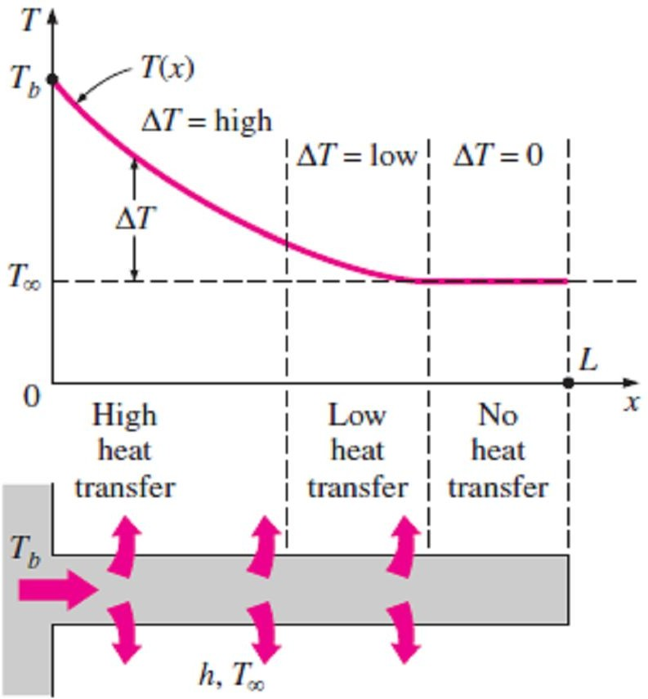
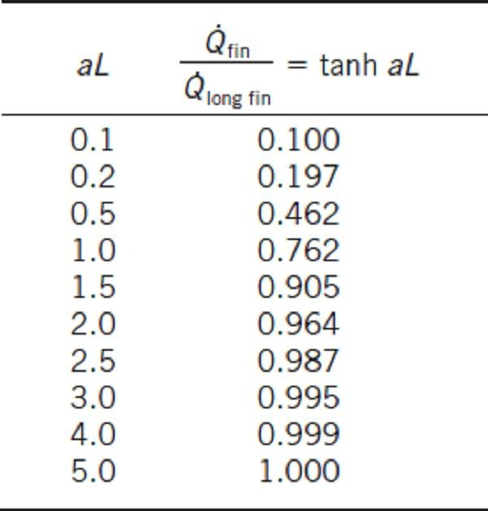
Chapter Three
Steady Heat Conduction
To get a sense of the proper length of a fin, we compare heat transfer from a fin of finite length to heat transfer from an infinitely long fin under the same conditions. The ratio of these two heat transfers is;
^{Q} fin
^{Q}long fin
=
h p k A_{c} (T_{b} − T∞ ) tanh aL h p k A_{c} (T_{b} − T∞ )
= tanh aL ☹(3.40)
the values of tanhaL are evaluated for some values of aL and the results are given in Table(3.1). We observe from the table that heat transfer from a fin increases with aL almost linearly at first, but the curve reaches a plateau later and reaches a value for the infinitely long fin at about aL=5. We also observe that reducing the fin length by half in that case (from aL=5 to aL=2.5) causes a drop of just 1% in heat transfer with 50% reduction in the size and possibly the cost of the fin. In practice, a fin length that corresponds to about aL = 1 will transfer 76.2% of the heat that can be transferred by an infinitely long fin, and thus it should offer a good compromise between heat transfer performance and the fin size.
Fig.(3.35) Because of the gradual temperature drop along the fin, the region near the fin tip makes little or no contribution to heat transfer
Table (3.1) The variation of heat
transfer from a fin relative to that from an infinitely long fin
EXAMPLE 3.8-
Copper-plate fins of rectangular cross section having a thickness t=1mm, Length L=10mm, and thermal conductivity k=380W/m∙C° are attached to a plane wall
maintained at a temperature Tb=230C°. The fins dissipate heat by convection into ambient at T∞=30C° with a heat transfer coefficient h=40W/m²∙C°. Assuming negligible heat loss from the fin tip determine the fin efficiency.
SOLUTION A fin of the second type (insulated fin tip) with thickness t=1mm, Length L=10mm, Tb=230C°, T∞=30C°, and h=40W/m²∙C°. The efficiency of this fin to be determined.
Assumptions 1 Heat transfer is steady 2 Heat transfer is one-dimensional 3 Thermal conductivities are constants. 4 Heat transfer coefficient incorporates the radiation effects.
Properties The thermal conductivity is constant k=380W/m∙C°
Analysis To determine the fin efficiency, we first calculate the parameter aL as follows;
p ₌ 2(b + t ) ₌ 2
A_{c} b t t
a =
h p
k A
=
2h k t
=
2(40W / m ² ⋅ C □ ) (380W / m ⋅ C □ )(10 ⁻³ m)
= 14 .51m
−1
c
a L = (14 .51m ⁻¹ )(10 ⁻² m) = 0.1451
By using Eq.(3.36.b) we can calculate the efficiency of the insulated tip fin as follow;

₌ tanh aL ₌ tanh( 0.1451 ) _{= 0.993 = 99.3%}
aL 0.1451
fin
EXAMPLE 3.9-
A steel rod of diameter D=2cm, length L=10cm, and thermal conductivity k=50W/m∙C°, is exposed to ambient air at T∞=20C° with a heat transfer coefficient h=30W/m²∙C°. If one end of the rod is maintained at a temperature of 70C°. calculate the heat loss from the rod, also find the temperature at the other end of the rod.
SOLUTION A rod with D=2cm=0.02m and L=10cm=0.1m, is exposed to air with T∞=20 C°, h=30W/m²∙C°, and the one end temperature is Tb=70 C°.

Slide 23


Chapter Three
Steady Heat Conduction
Assumptions 1 Heat transfer is steady 2 Heat transfer is one-dimensional 3 Thermal conductivities are constants. 4 Heat transfer coefficient incorporates the radiation effects. Properties The thermal conductivity of rod k=50W/m∙C° is constant. Analysis We can assume the rod to be a fin of the second type because it has a finite length. At the beginning we must calculate aL p ₌  D ₌ 4 A_{c} ⎛  D ² ⎞ D ⎜ ⎟ ⎝ ⁴ ⎠ h p 4 h 4 (30W / m ² ⋅ C □ ) ₋₁ a = = = = 10 .95 m k A_{c} k D (50 W / m ⋅ C □ )( 0 .02 m ) a L = (10 .95 m ⁻¹ )(0.1m ) = 1.095 By using Eq.(3.36.b) we can calculate the efficiency of the insulated tip fin as follow; Q =  Q = ^{⎛ tanh aL ⎞} h A (T − T ) = ^{⎛ kAc tanh aL ⎞} h ( pL)(T − T ) fin fin fin, max ⎜ ⎟ fin b ∞ ⎜ ⎟ b ∞ ⎝ aL ⎠ ⎜ hp L ⎟ ⎝ ⎠ = hpkA (T − T ) tanh aL = h(D)k (D ² / 4)(T − T ) tanh aL c b ∞ b ∞ = (30W / m ² ⋅ C □ )( 0.02m)(50W / m ⋅ C □ )[ (30W / m ² ⋅ C □ ) ² / 4](70C □ − 20C □ ) tanh(1.095) = 6.87W By using Eq.(3.30) we can calculate the temperature at the other end as follow; T (x) − T_{∞ =} cosh a(L − x) → T (L) − 20 ₌ cosh[10.95(L − L)] _{= 0.6017 → T (L) = 50.087C □} T_{b} − T∞ cosh aL 70 − 20 cosh(1.095)
3.10- Fig.(3.36). | Fig.(3.36) Schematic for Example- 3.10

Slide 24

Chapter Three
Steady Heat Conduction

Slide 25


Chapter Three
Steady Heat Conduction
PROBLEMS
3.1- Consider a 4m-high, 6m-wide, and 0.3m- thick brick wall whose thermal conductivity is
3.4- Repeat Problem(3.3), assuming the space between the two glass layers is evacuated.
k=0.8W/m·C° . On a certain day, the
3.5- Consider an electrically heated brick house (k = 0.40 Btu/h ·ft ·F°) whose walls are 9ft high and 1ft thick. Two of the walls of the house are 40ft long and the others are 30ft long. The house is maintained at 70F° at all times while the temperature of the outdoors varies. On a certain day, the temperature of the inner surface of the walls is measured to be at 55F° while the average temperature of the outer surface is observed to remain at 45F° during the day for 10h and at 35F° at night for 14h. Determine the amount of heat lost from the house that day. Also determine the cost of that heat loss to the homeowner for an electricity price of 0.09$ /kWh.
Answers: 191.520 Btu, 5.05$
temperatures of the inner and the outer surfaces of the wall are measured to be 14C° and 6C°,
respectively. Determine the rate of heat loss through the wall on that day. Answer: 512 W
3.2- Consider a 1.2m-high and 2m-wide glass window whose thickness is 6mm and thermal conductivity is k = 0.78 W/m ·C°. Determine the steady rate of heat transfer through this glass window and the temperature of its inner surface for a day during which the room is maintained at 24C° while the temperature of the outdoors is -
5C°. Take the convection heat transfer
coefficients on the inner and outer surfaces of the
window to be h₁ = 10 W/m² ·C° and h₂ = 25 W/m² ·C°, and disregard any heat transfer by radiation. Answers: 471 W, 4.4C°
3.3- Consider a 1.2m-high and 2m-wide double- pane window consisting of two 3mm-thick layers of glass (k = 0.78 W/m ·C°) separated by a 12mm-wide stagnant air space (k = 0.026 W/m·C°). Determine the steady rate of heat transfer through this double-pane window and the temperature of its inner surface for a day during which the room is maintained at 24C° while the temperature of the outdoors is -5C°. Take the convection heat transfer coefficients on the inner and outer surfaces of the window to be h₁ = 10 W/m² ·C° and h₂ = 25 W/m² ·C°, and disregard any heat transfer by radiation.
Answers: 114 W, 19.2C°
Prob.(3.5)
3.6- A cylindrical resistor element on a circuit board dissipates 0.15 W of power in an environment at 40C°. The resistor is 1.2cm long, and has a diameter of 0.3cm. Assuming heat to be
transferred uniformly from all surfaces,
determine (a) the amount of heat this resistor
dissipates during a 24-h period, (b) the heat flux on the surface of the resistor, in W/m², and (c) the surface temperature of the resistor for a combined convection and radiation heat transfer coefficient of 9 W/m² ·C°.
Answers: 3.6W·h, 1179W/m², 171C°
3.7- Water is boiling in a 25cm-diameter aluminum pan (k = 237 W/m ·C°) at 95C°. Heat is transferred steadily to the boiling water in the pan through its 0.5cm-thick flat bottom at a rate of 800 W. If the inner surface temperature of the bottom of the pan is 108C°, determine (a) the boiling heat transfer coefficient on the inner surface of the pan, and (b) the outer surface temperature of the bottom of the pan.
Answers: 1254 W/m² ·C°, 108.3C°
Prob.(3.3)
3.8- A wall is constructed of two layers of 0.5in- thick sheetrock (k = 0.10 Btu/h ·ft ·F°), which is

Slide 26



Chapter Three
Steady Heat Conduction
a plasterboard made of two layers of heavy paper separated by a layer of gypsum, placed 5in-apart. The space between the sheetrocks is filled with fiberglass insulation (k = 0.020 Btu/h ·ft ·F°). Determine the thermal resistance of the wall.
Answer: 21.66ft² ·F° ·h /Btu
3.10- A 2m×1.5m section of wall of an industrial furnace burning natural gas is not insulated, and the temperature at the outer surface of this section is measured to be 80C°. The temperature of the furnace room is 30C°, and the combined convection and radiation heat transfer coefficient at the surface of the outer furnace is 10 W/m² ·C°. It is proposed to insulate this section of the furnace wall with glass wool insulation (k =0.038 W/m ·C°) in order to reduce the heat loss by 90 percent. Assuming the outer surface temperature of the metal section still remains at about 80C°, determine the thickness of the insulation that
needs to be used. The furnace operates continuously and has an efficiency of 78 percent.
Prob.(3.8)
The price of the natural gas is 0.55$/therm (1 therm = 105,500 kJ of energy content). If the installation of the insulation will cost 250$ for materials and labor, determine how long it will take for the insulation to pay for itself from the
3.9- The roof of a house consists of a 3cm-thick concrete slab (k = 2 W/m ·C°) that is 15m-wide and 20m-long. The convection heat transfer coefficients on the inner and outer surfaces of the roof are 5 and 12 W/m² ·C°, respectively. On a clear winter night, the ambient air is reported to be at 10C°, while the night sky temperature is 100 K°. The house and the interior surfaces of the wall are maintained at a constant temperature of 20C°. The emissivity of both surfaces of the concrete roof is 0.9. Considering both radiation and convection heat transfers, determine the rate of heat transfer through the roof, and the inner surface temperature of the roof. If the house is heated by a furnace burning natural gas with an efficiency of 80 percent, and the price of natural gas is 0.6$/therm (1 therm=105,500 kJ of energy content), determine the money lost through the roof that night during a 14h period.
Answers: 37440W, 7.3C°, 13.4$
energy it saves. Answers: 3.4cm, 0.88year
3.11- Repeat Prob.(3.10) for expanded perlite insulation assuming conductivity is k = 0.052 W/m ·C°. Answers: 4.7cm, 0.88year
3.12- Consider a house whose walls are 12ft-high and 40ft-long. Two of the walls of the house have no windows, while each of the other two walls has four windows made of 0.25in-thick glass (k =
0.45 Btu/h ·ft ·F°), 3ft×5ft in size. The walls are certified to have an R-value of (L/k = 19h ·ft²
F°/Btu). Disregarding any direct radiation gain
or loss through the windows and taking the heat transfer coefficients at the inner and outer surfaces of the house to be 2 and 4 Btu/h ·ft² ·F°,
respectively, determine the transfer through the walls windows.
ratio of the heat with and without Answer: 17.7
Prob.(3.12)
3.13- Consider a house that has a 10m×20m-base and a 4m-high wall. All four walls of the house have an R-value of 2.31m² ·C°/W. The two 10m×4m-walls have no windows. The third wall
Prob.(3.9)
66

Slide 27


Chapter Three
Steady Heat Conduction
has five windows made of 0.5cm-thick glass (k =
0.78 W/m ·C°), 1.2m×1.8m in size. The fourth wall has the same size and number of windows, but they are double-paned with a 1.5cm-thick stagnant air space (k = 0.026 W/m ·C°) enclosed between two 0.5cm-thick glass layers. The thermostat in the house is set at 22C° and the average temperature outside at that location is 8C° during the seven-month-long heating season. Disregarding any direct radiation gain or loss through the windows and taking the heat transfer coefficients at the inner and outer surfaces of the house to be 7 and 15 W/m² ·C°, respectively, determine the average rate of heat transfer through each wall. If the house is electrically heated and the price of electricity is 0.08$/kWh, determine the amount of money this household will save per heating season by converting the single-pane windows to double-pane windows.
. Answers: 222.3W, 4372W, 600W, 1521$
1.2mm, respectively. Disregarding heat transfer from side surfaces, determine the percentages of heat conduction along the copper (k = 386 W/m·C°) and epoxy (k = 0.26 W/m ·C°) layers. Also determine the effective thermal conductivity of the board.
Answers: 99.2%, 0.8%, 29.9 W/m ·C°
3.16- A 0.03in-thick copper plate (k = 223 Btu/h
ft ·F°) is sandwiched between two 0.1in-thick epoxy boards (k = 0.15 Btu/h ·ft ·F°) that are 7in×9in in size. Determine the effective thermal conductivity of the board along its 9in-long side. What fraction of the heat conducted along that side is conducted through copper?
Answers: 29.2 Btu/h ·ft ·F°, 99.6%
3.17- A 4m-high and 6m-wide wall consists of a long 18cm×30cm cross section of horizontal bricks (k = 0.72 W/m ·C°) separated by 3cm- thick plaster layers (k = 0.22 W/m ·C°). There are also 2cm-thick plaster layers on each side of the wall, and a 2cm-thick rigid foam (k =0.026 W/m
C°) on the inner side of the wall. The indoor and the outdoor temperatures are 22C° and -4C°, and the convection heat transfer coefficients on the inner and the outer sides are h₁ = 10 W/m² ·C° and h₂ = 20 W/m² ·C°, respectively. Assuming one-dimensional heat transfer and disregarding radiation, determine the rate of heat transfer through the wall. Answer: 450 W
3.14- The wall of a refrigerator is constructed of
fiberglass insulation (k = 0.035 W/m ·C°) set
between two layers of 1mm-thick sheet metal (k=
15.1 W/m ·C°). The refrigerated space is maintained at 3C°, and the average heat transfer coefficients at the inner and outer surfaces of the wall are 4 and 9 W/m² ·C°, respectively. The kitchen temperature averages 25C°. It is observed that condensation occurs on the outer surfaces of the refrigerator when the temperature of the outer surface drops to 20C°. Determine the minimum thickness of fiberglass insulation that needs to be used in the wall in order to avoid condensation on
the outer surfaces. Answer: 0.45cm
Prob.(3.17)
Prob.(3.14)
3.18- A 10in-thick, 30ft-long, and 10ft-high wall is to be constructed using 9in-long solid bricks (k
= 0.4 Btu/h ·ft ·F°) of cross section 7in×7in, or identical size bricks with nine square air holes (k
= 0.015 Btu/h ·ft ·F°) that are 9in-long and have a cross section of 1.5in×1.5in. There is a 0.5in-
thick plaster layer (k =0.10 Btu/h ·ft ·F°) between
3.15- Heat is to be conducted along a circuit board that has a copper layer on one side and epoxy layer on other side. The circuit board is 15cm-long and 15cm-wide, and the thicknesses of the copper and epoxy layers are 0.1mm and

Slide 28




Chapter Three
Steady Heat Conduction
two adjacent bricks on all four sides and on both sides of the wall. The house is maintained at 80F° and the ambient temperature outside is 30F°. Taking the heat transfer coefficients at the inner and outer surfaces of the wall to be 1.5 and 4 Btu/h ·ft² ·F°, respectively, determine the rate of heat transfer through the wall constructed of
(a) solid bricks and (b) bricks with air holes.
Answers: 3921 Btu/h, 3275 Btu/h
3.20- A 5m-wide, 4m-high, and 40m-long kiln used to cure concrete pipes is made of 20cm- thick concrete walls and ceiling (k =0.9W/m ·C°). The kiln is maintained at 40C° by injecting hot steam into it. The two ends of the kiln, 4m×5m in size, are made of a 3mm-thick sheet metal covered with 2cm-thick Styrofoam (k = 0.033
W/m·C°). The convection heat transfer
coefficients on the inner and the outer surfaces of
the kiln are 3000 and 25 W/m² ·C°, respectively. Disregarding any heat loss through the floor, determine the rate of heat loss from the kiln when the ambient air is at -4C°.
Answer: 88,000 W
Prob.(3.18)
Prob.(3.20)
3.19- Consider a 5m-high, 8m-long, and 0.22m- thick wall whose representative cross section is as given in the figure. The thermal conductivities of various materials used, in W/m ·C°, are k_{A} = k_{F}
= 2, k_{B} = 8, k_{C} = 20, k_{D} = 15 and k_{E} = 35. The
left and right surfaces of the wall are maintained at uniform temperatures of 300C° and 100C°, respectively. Assuming heat transfer through the wall to be one-dimensional, determine (a) the rate of heat transfer through the wall; (b) the temperature at the point where the sections B, D, and E meet; and (c) the temperature drop across the section F. Disregard any contact resistances at the interfaces.
Answers: 1.91×10⁵W, 263C°, 143C°
3.21- Consider a 6in×8in epoxy glass laminate (k
= 0.10 Btu/h ·ft ·F°) whose thickness is 0.05in. In order to reduce the thermal resistance across its thickness, cylindrical copper fillings (k = 223 Btu/h ·ft ·F°) of 0.02in diameter are to be planted throughout the board, with a center-to-center distance of 0.06in. Determine the new value of the thermal resistance of the epoxy board for heat conduction across its thickness as a result of this modification.
Answer: 0.00064 h ·F°/Btu
Prob.(3.19)
Prob.(3.21)

Slide 29



Chapter Three
Steady Heat Conduction
3.22- A 5m-internal-diameter spherical tank made of 1.5cm-thick stainless steel (k = 15 W/m
C°) is used to store iced water at 0C°. The tank is
located in a room whose temperature is 30C°. The walls of the room are also at 30C°. The outer surface of the tank is black (emissivity ε = 1), and heat transfer between the outer surface of the tank and the surroundings is by natural convection and
gas is 0.52$/therm (1 therm = 105,500 kJ), and
(c) the thickness of fiberglass insulation (k=0.035 W/m ·C°) needed in order to save 90% of the heat lost. Assume the pipe temperature to remain constant at 150C°.
Answers: 42,412 W, 8790$ /year,1.92cm
radiation. The convection heat transfer
coefficients at the inner and the outer surfaces of the tank are 80 and 10 W/m² ·C°, respectively. Determine (a) the rate of heat transfer to the iced water in the tank and (b) the amount of ice at 0C° that melts during a 24h-period. The heat of fusion of water at atmospheric pressure is h_{if} = 333.7
kJ/kg. Answers: 30,581 W, 7918kg
Prob.(3.24)
3.25- Steam exiting the turbine of a steam power plant at 100F° is to be condensed in a large condenser by cooling water flowing through copper pipes (k = 223 Btu/h ·ft ·F°) of inner diameter 0.4in and outer diameter 0.6in at an average temperature of 70F°. The heat of vaporization of water at 100F° is 1037 Btu/lbm. The heat transfer coefficients are 1500 Btu/h ·ft²
F° on the steam side and 35 Btu/h ·ft² ·F° on the
Prob.(3.22)
3.23- Steam at 320C° flows in a stainless steel pipe (k = 15 W/m ·C°) whose inner and outer diameters are 5cm and 5.5cm, respectively. The pipe is covered with 3cm-thick glass wool insulation (k = 0.038 W/m ·C°). Heat is lost to the surroundings at 5C° by natural convection and radiation, with a combined natural convection and radiation heat transfer coefficient of 15 W/m²
C°. Taking the heat transfer coefficient inside the
pipe to be 80W/m² ·C°, determine the rate of heat loss from the steam per unit length of the pipe. Also determine the temperature drops across the pipe shell and the insulation.
Answers: 93.9 W, 0.095C°, 290C°
water side. required to lbm/h.
Determine the length of the tube condense steam at a rate of 120
Answer: 1148 ft
Prob.(3.25)
3.24- A 50m-long section of a steam pipe whose outer diameter is 10cm passes through an open space at 15C°. The average temperature of the outer surface of the pipe is measured to be 150C°. If the combined heat transfer coefficient on the outer surface of the pipe is 20 W/m² ·C°, determine (a) the rate of heat loss from the steam pipe, (b) the annual cost of this energy lost if steam is generated in a natural gas furnace that has an efficiency of 75% and the price of natural
3.26- Consider a 3m-diameter spherical tank that is initially filled with liquid nitrogen at 1 atm and
-196C°. The tank is exposed to ambient air at
15C°, with a combined convection and radiation heat transfer coefficient of 35 W/m²·C°. The temperature of the thin-shelled spherical tank is
observed to be almost the same as the
temperature of the nitrogen inside. If the heat of vaporization liquid nitrogen at 1 atm is given to

Slide 30




Chapter Three
Steady Heat Conduction
be 198kJ/kg. Determine the rate of evaporation of the liquid nitrogen in the tank as a result of the heat transfer from the ambient air if the tank is
(a) not insulated, (b) insulated with 5cm-thick fiberglass insulation (k = 0.035 W/m ·C°), and (c) insulated with 2cm-thick super-insulation which has an effective thermal conductivity of 0.00005 W/m ·C°.
Answers: 1.055kg/s, 0.0214kg/s, 0.000076kg/s
3.29- A 5mm-diameter spherical ball at 50C° is covered by a 1mm-thick plastic insulation (k =
0.13 W/m ·C°). The ball is exposed to a medium
at 15C°, with a combined convection and radiation heat transfer coefficient of 20W/m² ·C°. Determine if the plastic insulation on the ball will help or hurt heat transfer from the ball.
Answer: It helps
Prob.(3.29)
3.30- Obtain a relation for the fin efficiency for a fin of constant cross-sectional area A_{c}, perimeter p, length L, and thermal conductivity k exposed to convection to a medium at T∞ with a heat transfer coefficient h. Assume the fins are sufficiently long so that the temperature of the fin at the tip is nearly T∞. Take the temperature of the fin at the base to be T_{b} and neglect heat transfer from the fin tips. Simplify the relation for
(a) a circular fin of diameter D & (b) rectangular fins of thickness t.
Prob.(3.26)
3.27- A 2mm-diameter and 10m-long electric wire is tightly wrapped with a 1mm-thick plastic cover whose thermal conductivity is k =0.15 W/m
C°. Electrical measurements indicate that a
current of 10A passes through the wire and there is a voltage drop of 8V along the wire. If the insulated wire is exposed to a medium at T∞=30C° with a heat transfer coefficient of h= 24 W/m² ·C°, determine the temperature at the interface of the wire and the plastic cover in steady operation. Also determine if doubling the thickness of the plastic cover will increase or decrease this interface temperature.
Answer: 62.4 C°, It decrease
3.31- Steam in a heating system flows through tubes whose outer diameter is 5cm and whose walls are maintained at a temperature of 180C°. Circular aluminum fins (k = 186 W/m ·C°) of outer diameter 6cm and constant thickness 1mm are attached to the tube. The space between the fins is 3mm, and thus there are 250 fins per meter length of the tube. Heat is transferred to the surrounding air at T∞ = 25C°, with a heat transfer coefficient of 40 W/m² ·C°. Determine the increase in heat transfer from the tube per meter of its length as a result of adding fins.
Answer: 2639 W
Prob.(3.27)
3.28- A 0.083in-diameter electrical wire at 115F°
is covered by 0.02in-thick plastic insulation (k =
0.075 Btu/h ·ft ·F°). The wire is exposed to a medium at 50F° with a combined convection and radiation heat transfer coefficient of 2.5 Btu/h ·ft²
F°. Determine if the plastic insulation on the
wire will increase or decrease heat transfer from the wire.
Answer: It helps
Prob.(3.31)

Slide 31



Chapter Three
Steady Heat Conduction
3.32- Consider a stainless steel spoon (k = 8.7 Btu/h ·ft ·F°) partially immersed in boiling water at 200F° in a kitchen at 75F°. The handle of the spoon has a cross section of 0.08in×0.5in, and extends 7in in the air from the free surface of the water. If the heat transfer coefficient at the exposed surfaces of the spoon handle is 3 Btu/h
ft² ·F°, determine the temperature difference across the exposed surface of the spoon handle. State your assumptions.
Answer: 124.6 F°
3.36- Two 3m-long and 0.4cm-thick cast iron (k
= 52 W/m ·C°) steam pipes of outer diameter 10cm are connected to each other through two 1cm-thick flanges of outer diameter 20cm. The steam flows inside the pipe at an average temperature of 200C° with a heat transfer coefficient of 180 W/m² ·C°. The outer surface of the pipe is exposed to an ambient at 12C°, with a heat transfer coefficient of 25W/m²·°C. (a) Disregarding the flanges, determine the average outer surface temperature of the pipe. (b) Using this temperature for the base of the flange and treating the flanges as the fins, determine the fin efficiency and the rate of heat transfer from the flanges. (c) What length of pipe is the flange section equivalent to for heat transfer purposes?
Answers: 174.8 C°, 0.88, 214 W, 8.35cm
Prob.(3.32)
3.33- Repeat Prob.(3.32) for a silver spoon (k = 247 Btu/h .ft ·F°).
Answer: 55.9 F°
3.34- A hot surface at 100C° is to be cooled by attaching 3cm-long, 0.25cm-diameter aluminum pin fins (k = 237 W/m ·C°) to it, with a center-to- center distance of 0.6cm. The temperature of the surrounding medium is 30C°, and the heat transfer coefficient on the surfaces is 35 W/m²
C°. Determine the rate of heat transfer from the surface for a 1m×1m section of the plate. Also determine the overall effectiveness of the fins.
Answers: 17.4 kW, 7.1
Prob.(3.36)
Prob.(3.34)
3.35- Repeat Prob.(3.34) using copper fins (k = 386 W/m ·C°) instead of aluminum ones.
Answers: 17.8 kW, 7.27

